Slide 1
Disaster and Healthcare Management
Project Done By: Dev Mithunisvar Premraj | Aneesh Koka | Shushil Girish | Pranav Krishna Anand

Slide 2


Slide 3
Contents
Problem Statement | Developing efficient and resilient systems for disaster response and healthcare management to ensure timely, effective care and resource allocation in crisis situations.
Introduction | The increasing frequency and severity of global disasters and health crises underscore the critical need for effective disaster and healthcare management, ensuring swift, coordinated responses to save lives and maintain health systems' integrity.
Objective of the System | The primary objective of this system is to provide a rapid, coordinated, and effective response to disasters and health emergencies, ensuring the optimal allocation of resources, timely medical care, and the minimization of loss of life and long-term health impacts.
Roles and Enterprises | All the roles and enterprises are mentioned in the upcoming slides.
User Interface | All the User Interfaces are attached with screenshots.
Result | The system has demonstrated improved response times, efficient resource utilization, and a significant reduction in mortality and morbidity rates during disasters and health crises, indicating a robust and effective disaster and healthcare management approach.

Slide 4
Group Members
01
02
03
04
Dev Mithunisvar Premraj
Aneesh Koka
Shushil Girish
Pranav Krishna Anand

Slide 5
01
Introduction

Slide 6
Strengthening Response and Resilience: Advanced Disaster and Healthcare Management Systems
Addressing the rise in natural and man-made disasters and emerging health challenges through advanced disaster and healthcare management systems.
Focused on efficient resource management and coordinated response during crises.
Critical in minimizing community impact, reducing mortality rates in disaster situations.
Ensuring resilience and continuity of healthcare services during and after emergencies.

Slide 7
Objective of the System
To rapidly and effectively respond to emergencies, minimizing response time in disaster and health crisis situations.
To optimize resource allocation and management, ensuring the best use of available resources during emergencies.
To reduce mortality and morbidity rates by providing timely and effective medical care in crisis situations.
To enhance coordination and communication among various stakeholders for a unified response strategy.
To ensure the resilience and sustainability of healthcare systems during and after disasters and health crises.

Slide 8
Roles and Enterprises
In the disaster and healthcare management system, key roles and enterprises include:
Medical Staff (Doctors, Nurses): Provide critical care and utilize system resources.
Patients: Central focus, driving system's response and adaptation.
Support Roles (Accountants, Logistic Teams): Manage finances and logistics.
Emergency Responders (Search and Rescue, ERS): Conduct field operations based on system coordination.
Volunteers: Supplement workforce, guided by the system's framework.
Organizational Entities (Enterprise Team, Government, Hospitals, Supply Chain Team): Oversee system functionality, policy implementation, and resource allocation.
External Partners (Funding Teams, Suppliers)**: Ensure financial and material supply continuity.

Slide 9
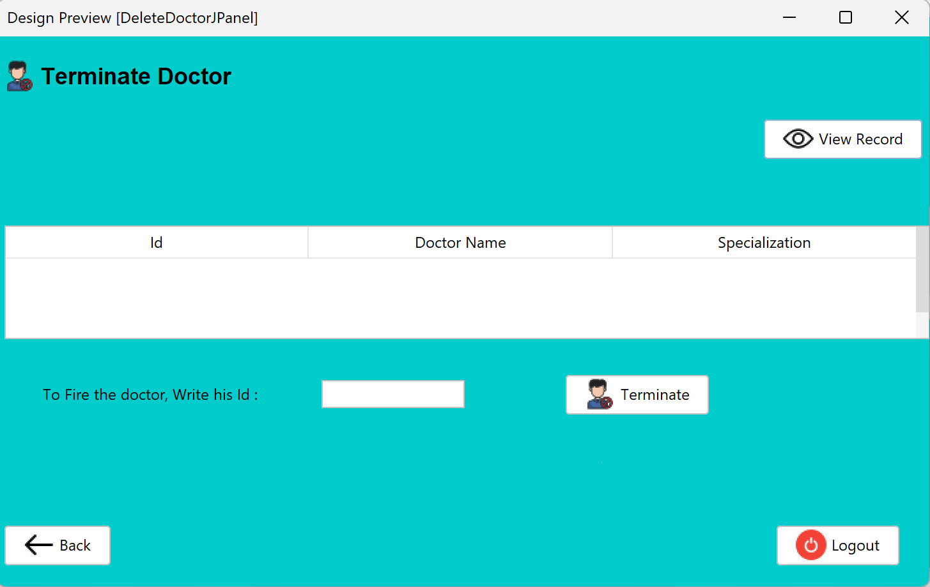
Terminate Doctor

Slide 10
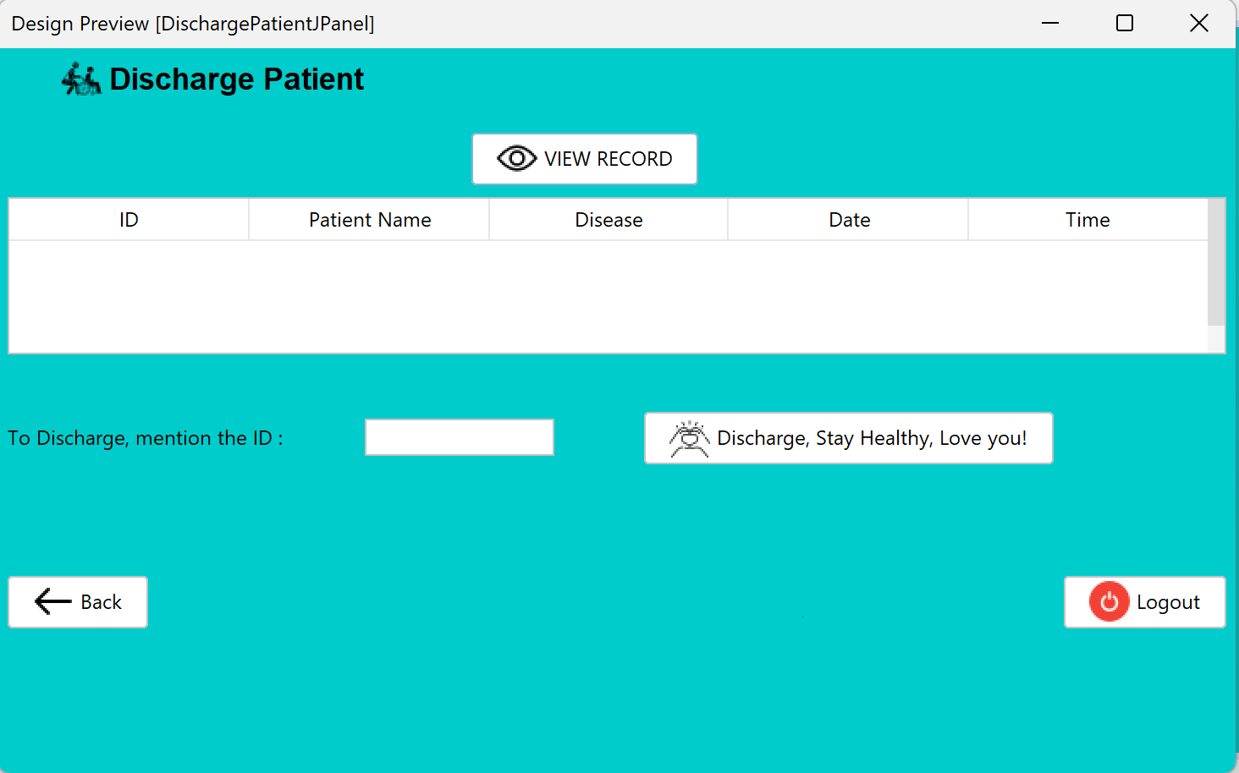
Discharge Patient

Slide 11
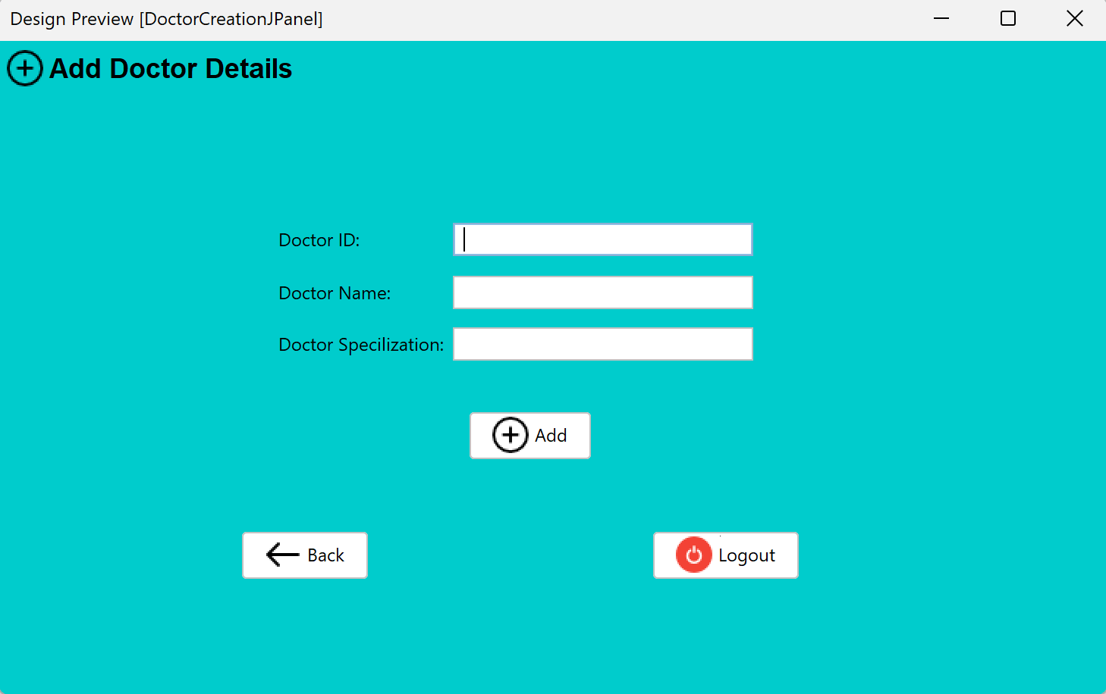
Adding Doctor Details

Slide 12
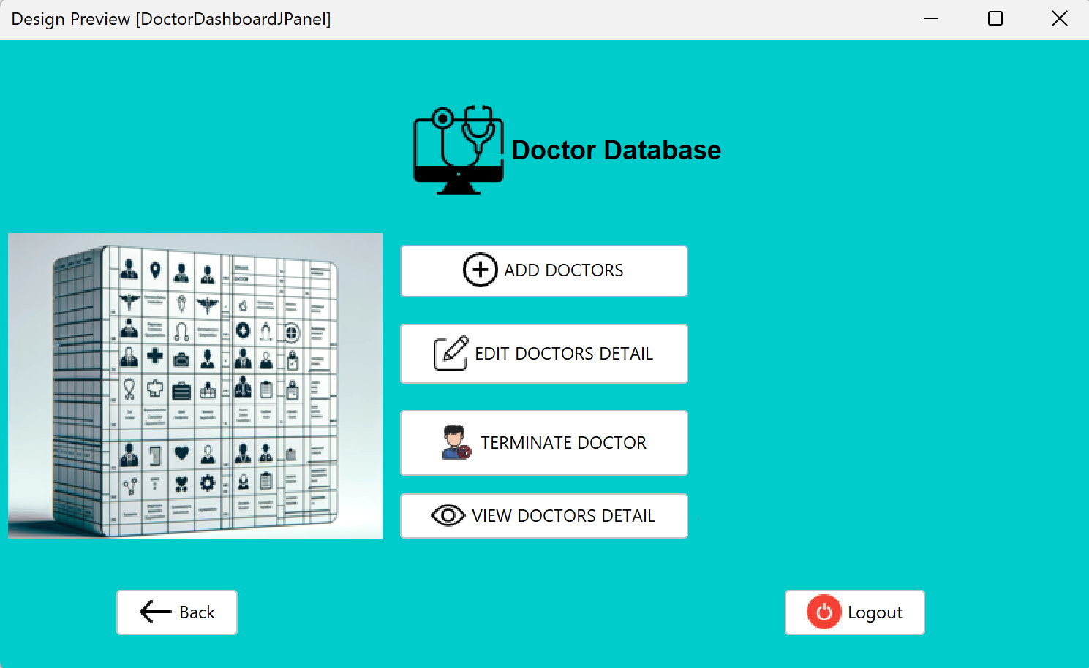
Doctor Database

Slide 13
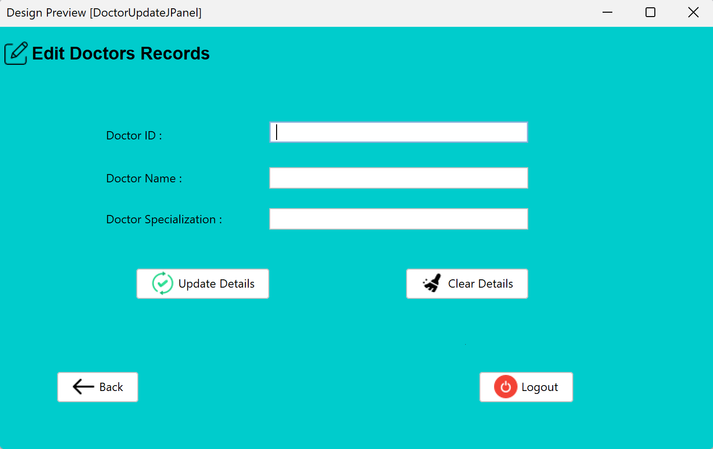
Edit/ Update Doctor Details

Slide 14
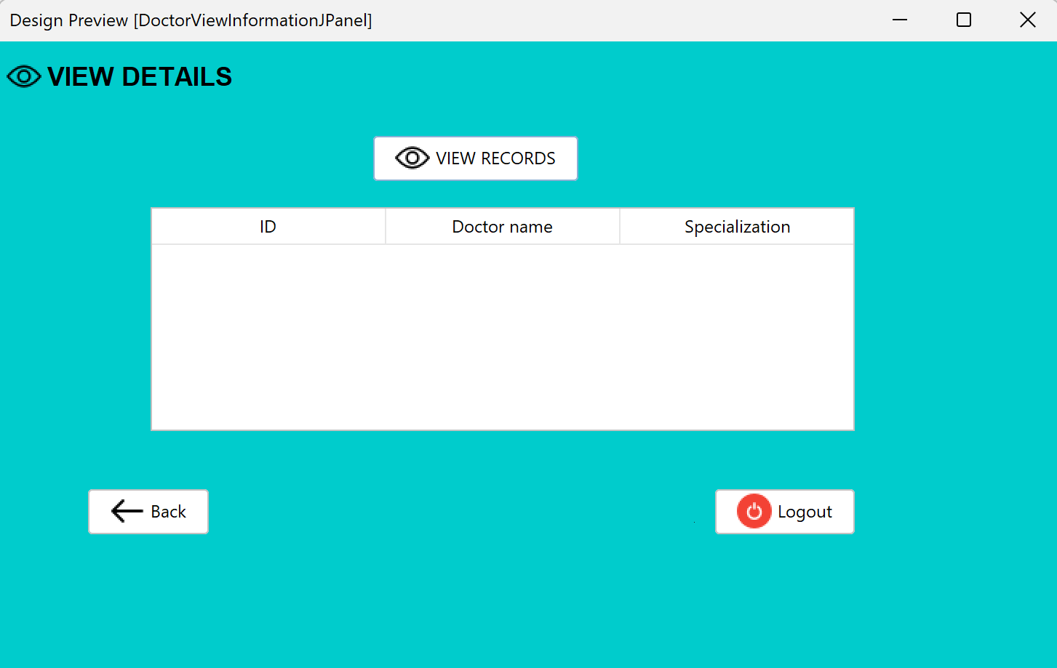
View Doctor Information

Slide 15
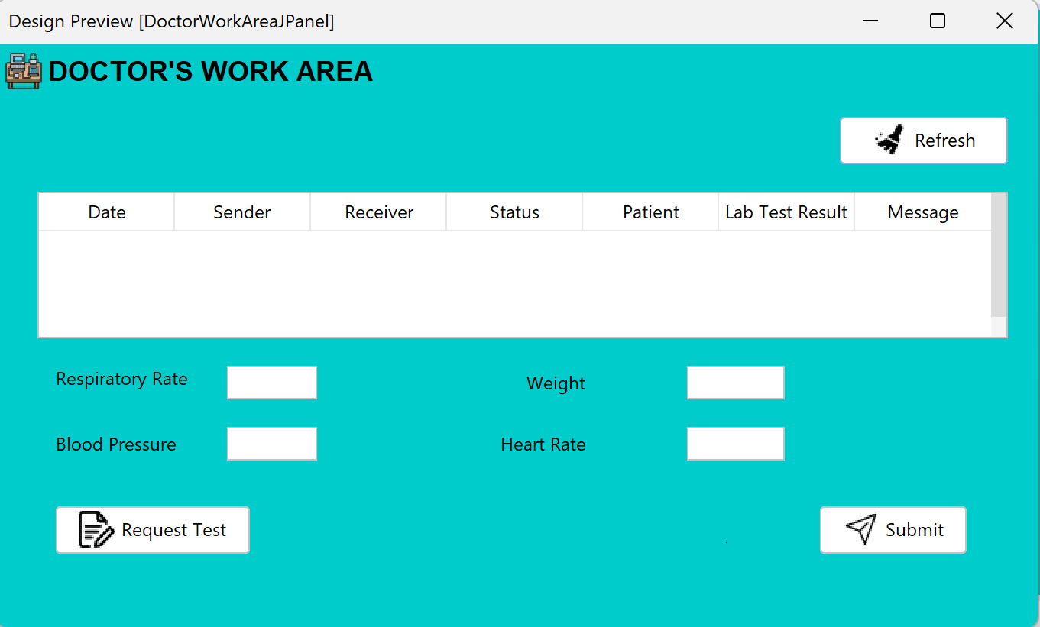
Doctor Work Area

Slide 16
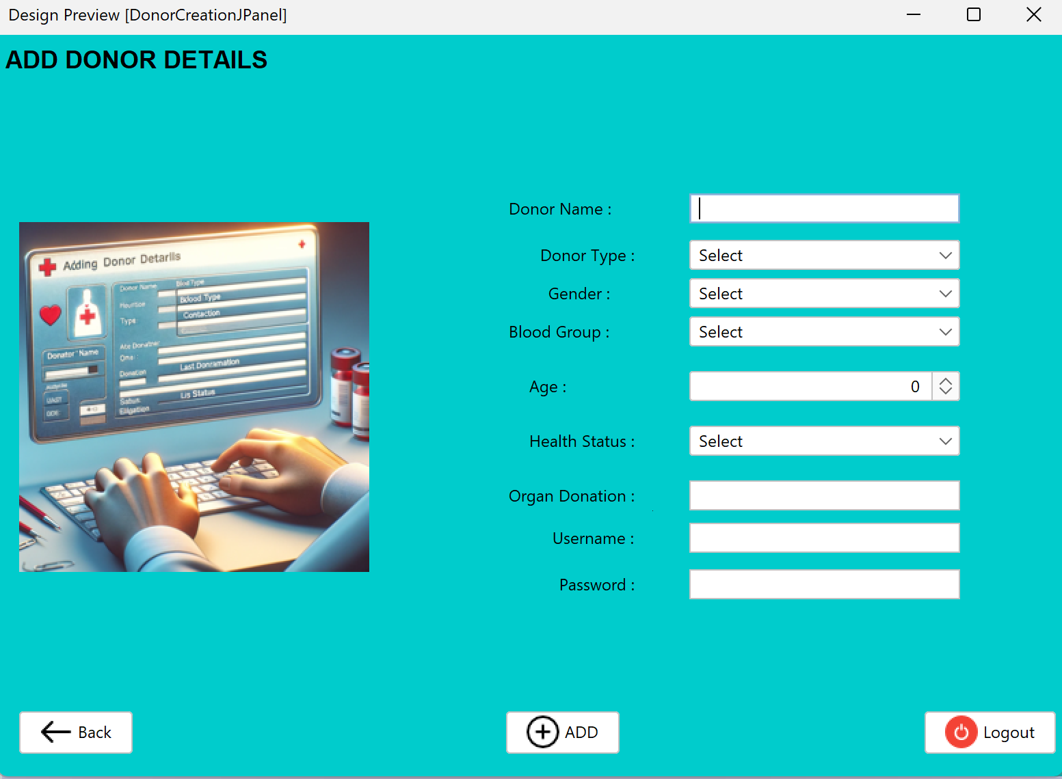
Add Donor Details

Slide 17
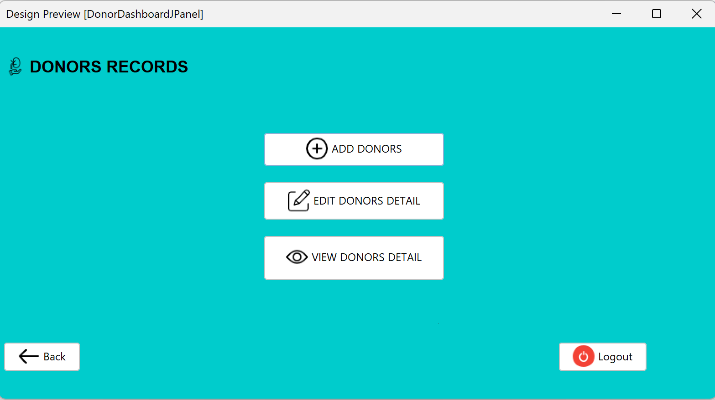
Donor Records

Slide 18
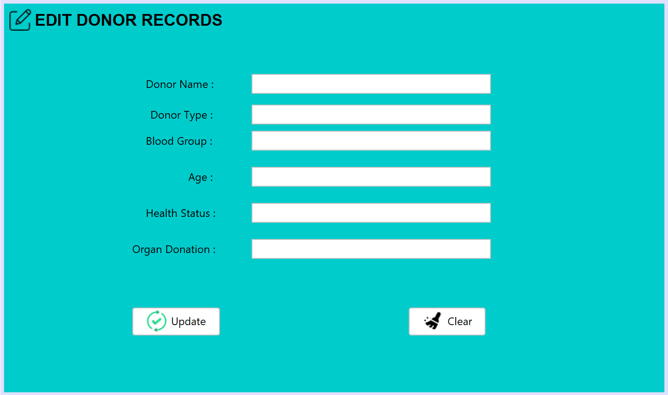
Edit Donor Records

Slide 19
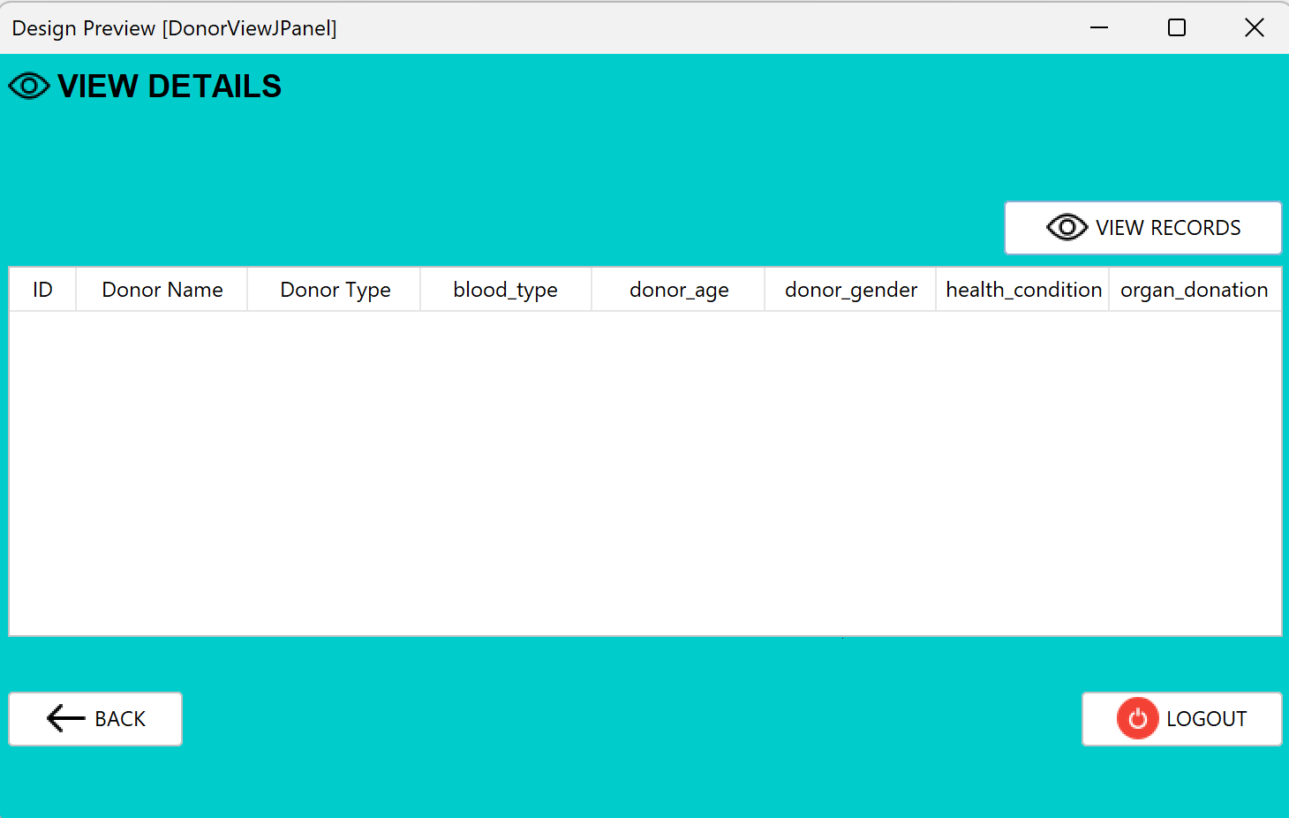
View Donor Details

Slide 20
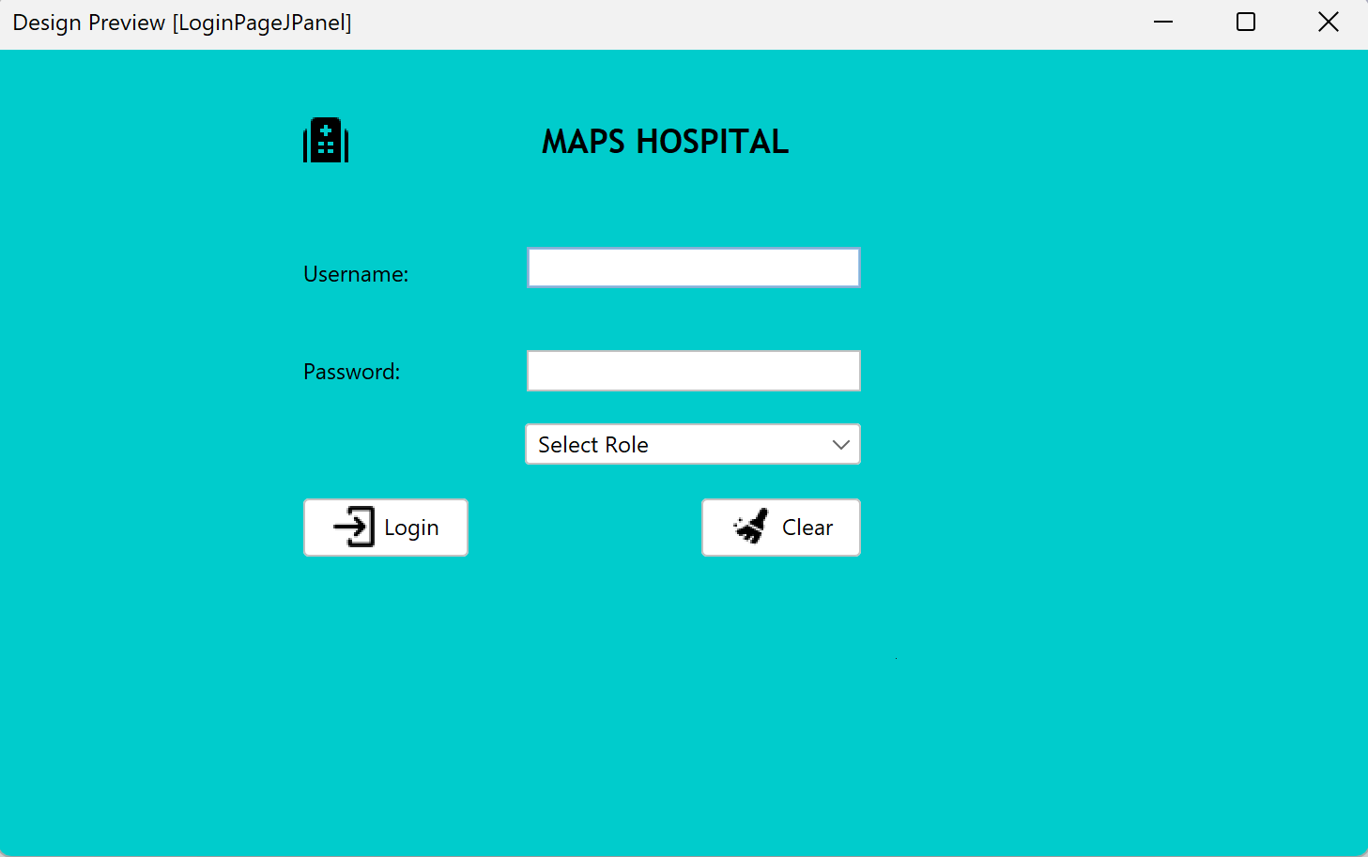
Hospital Login

Slide 21
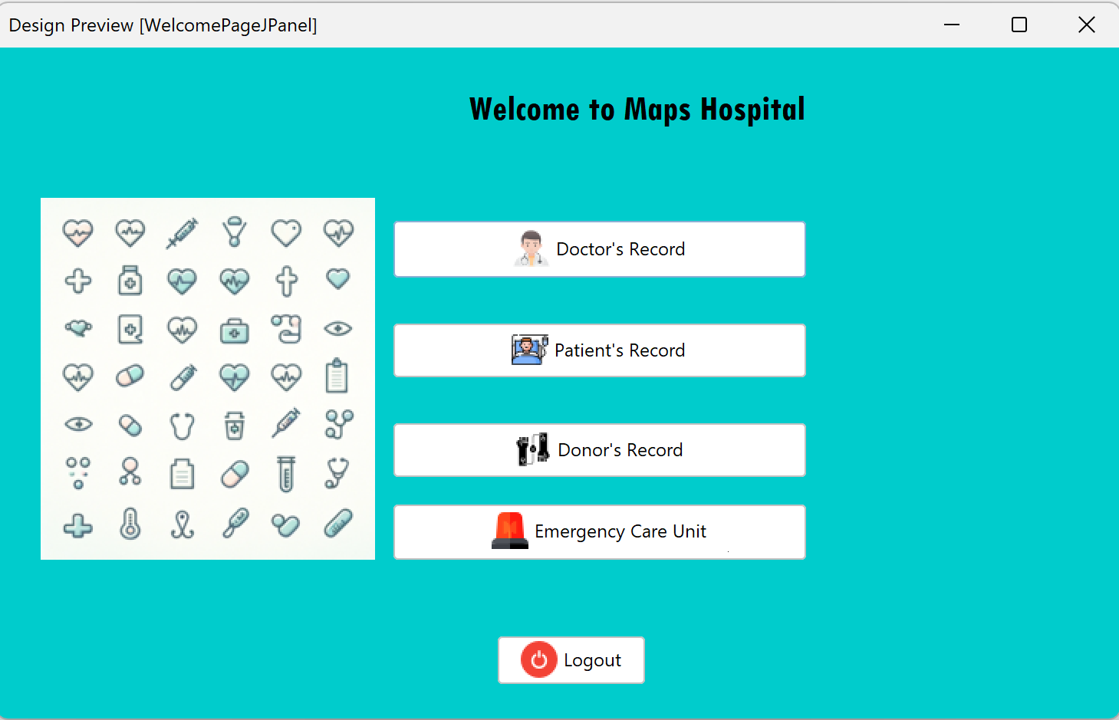
Hospital Main Page

Slide 22
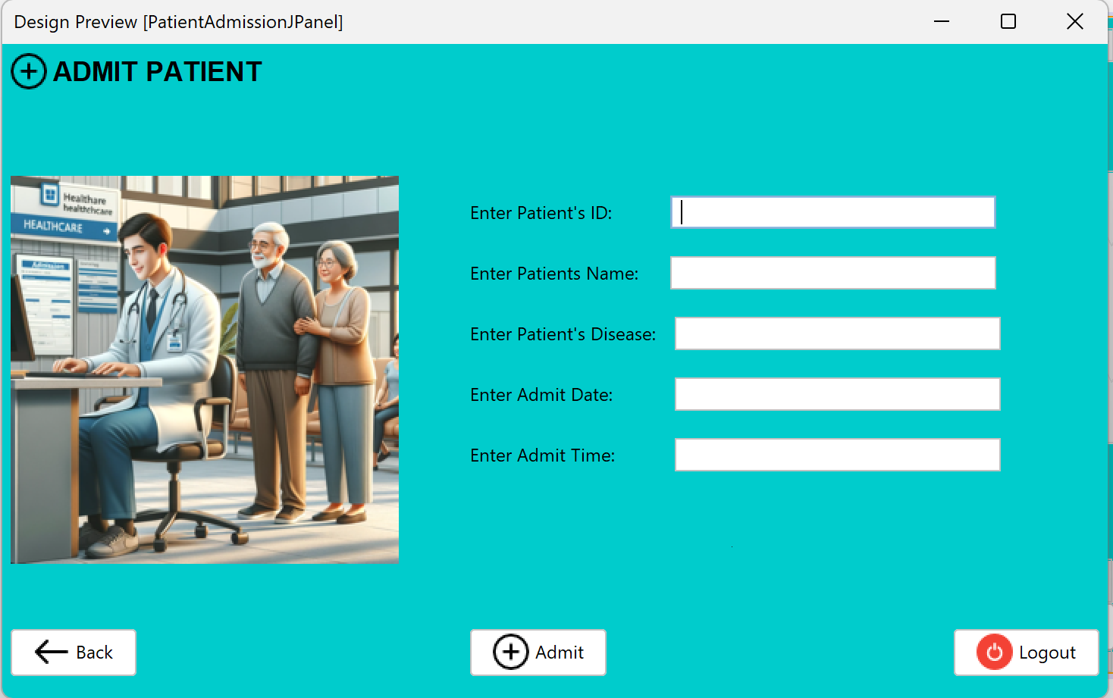
Admit Patient

Slide 23
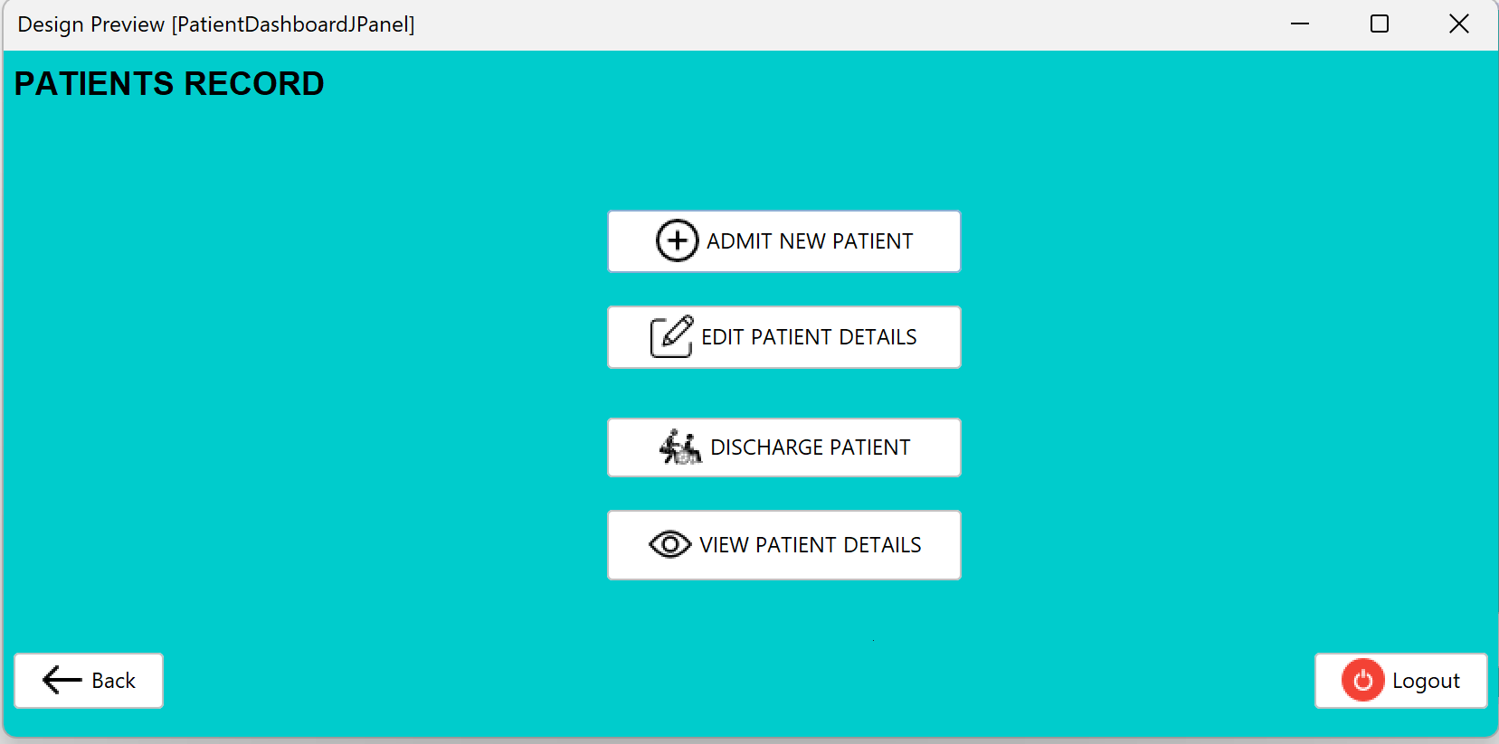
Patient Record Dashboard

Slide 24
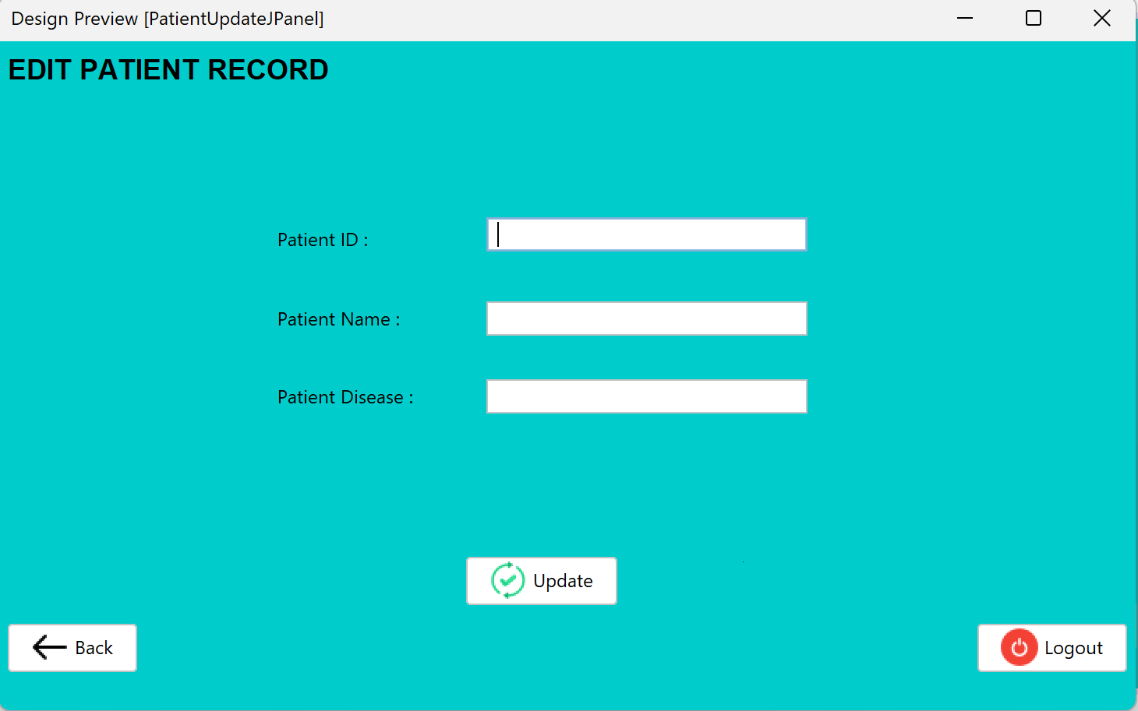
Edit Patient Record

Slide 25
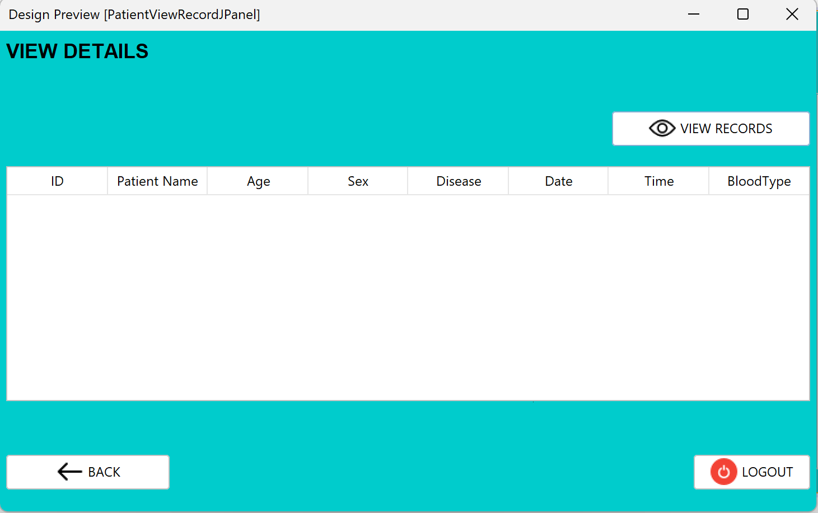
View Patient Details

Slide 26
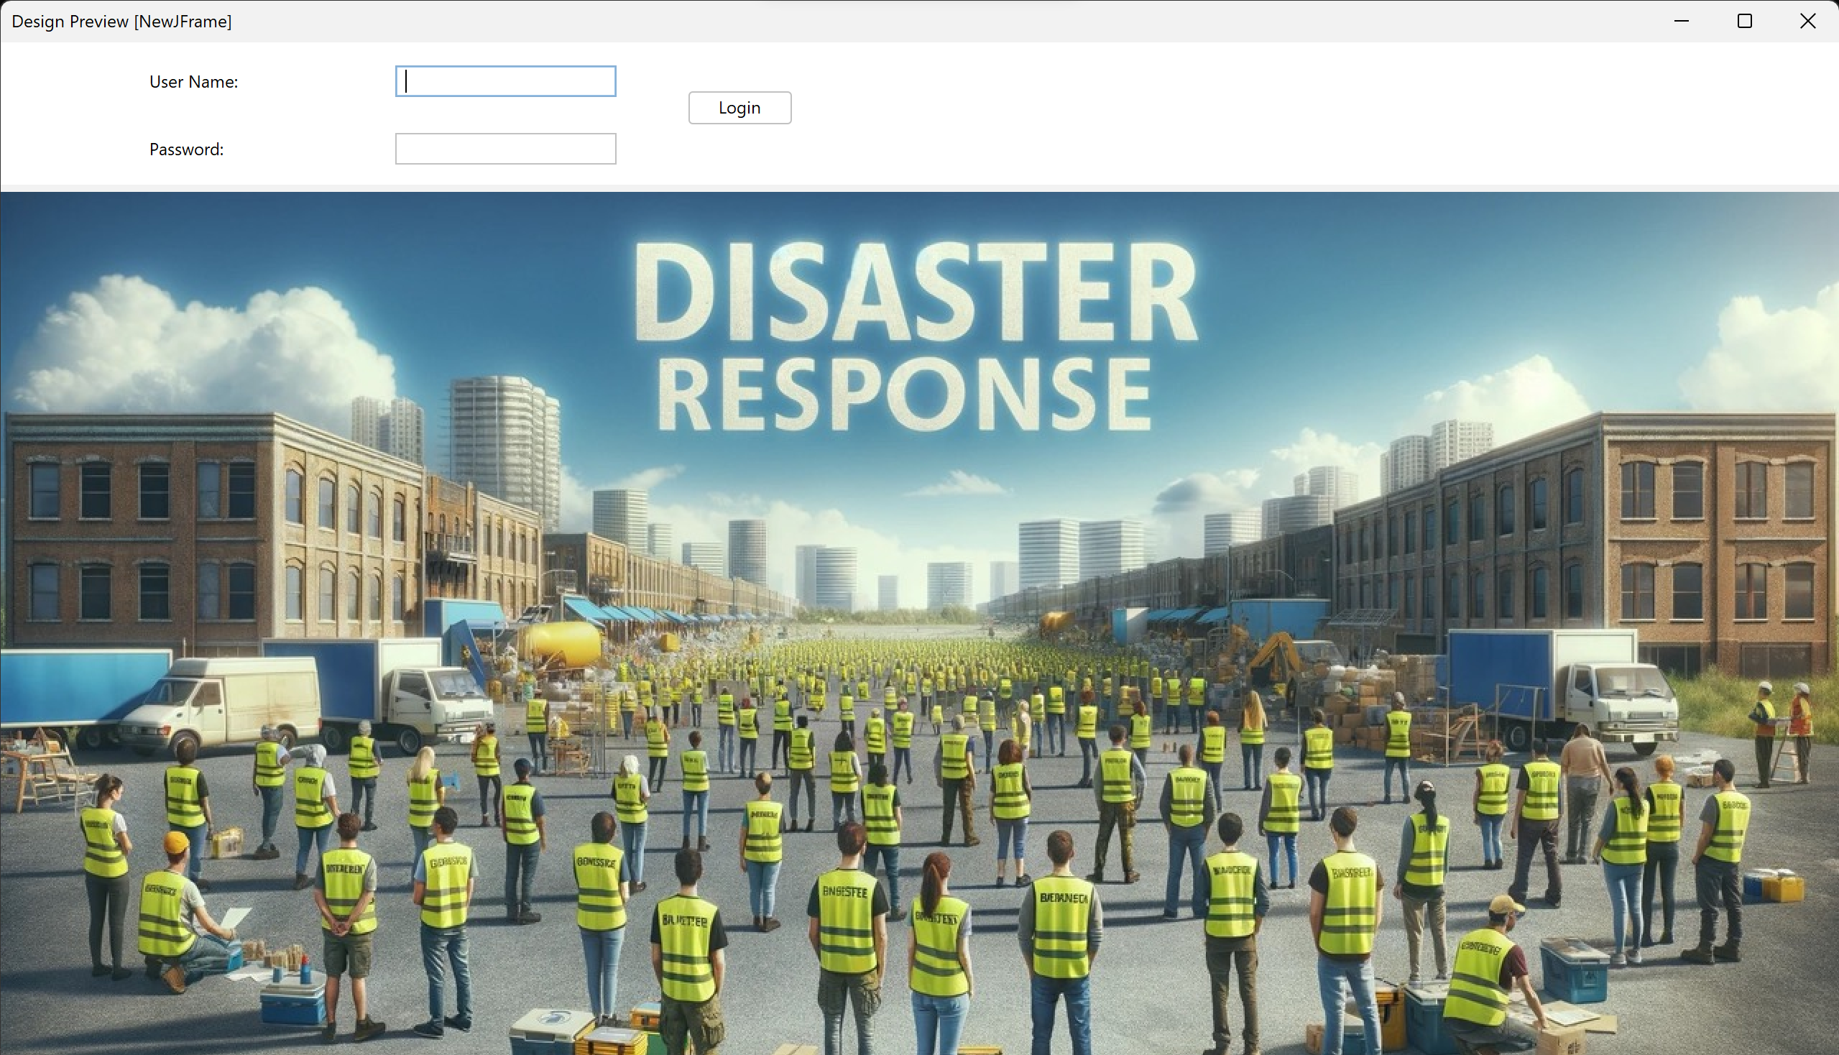
Disaster Recovery Login

Slide 27
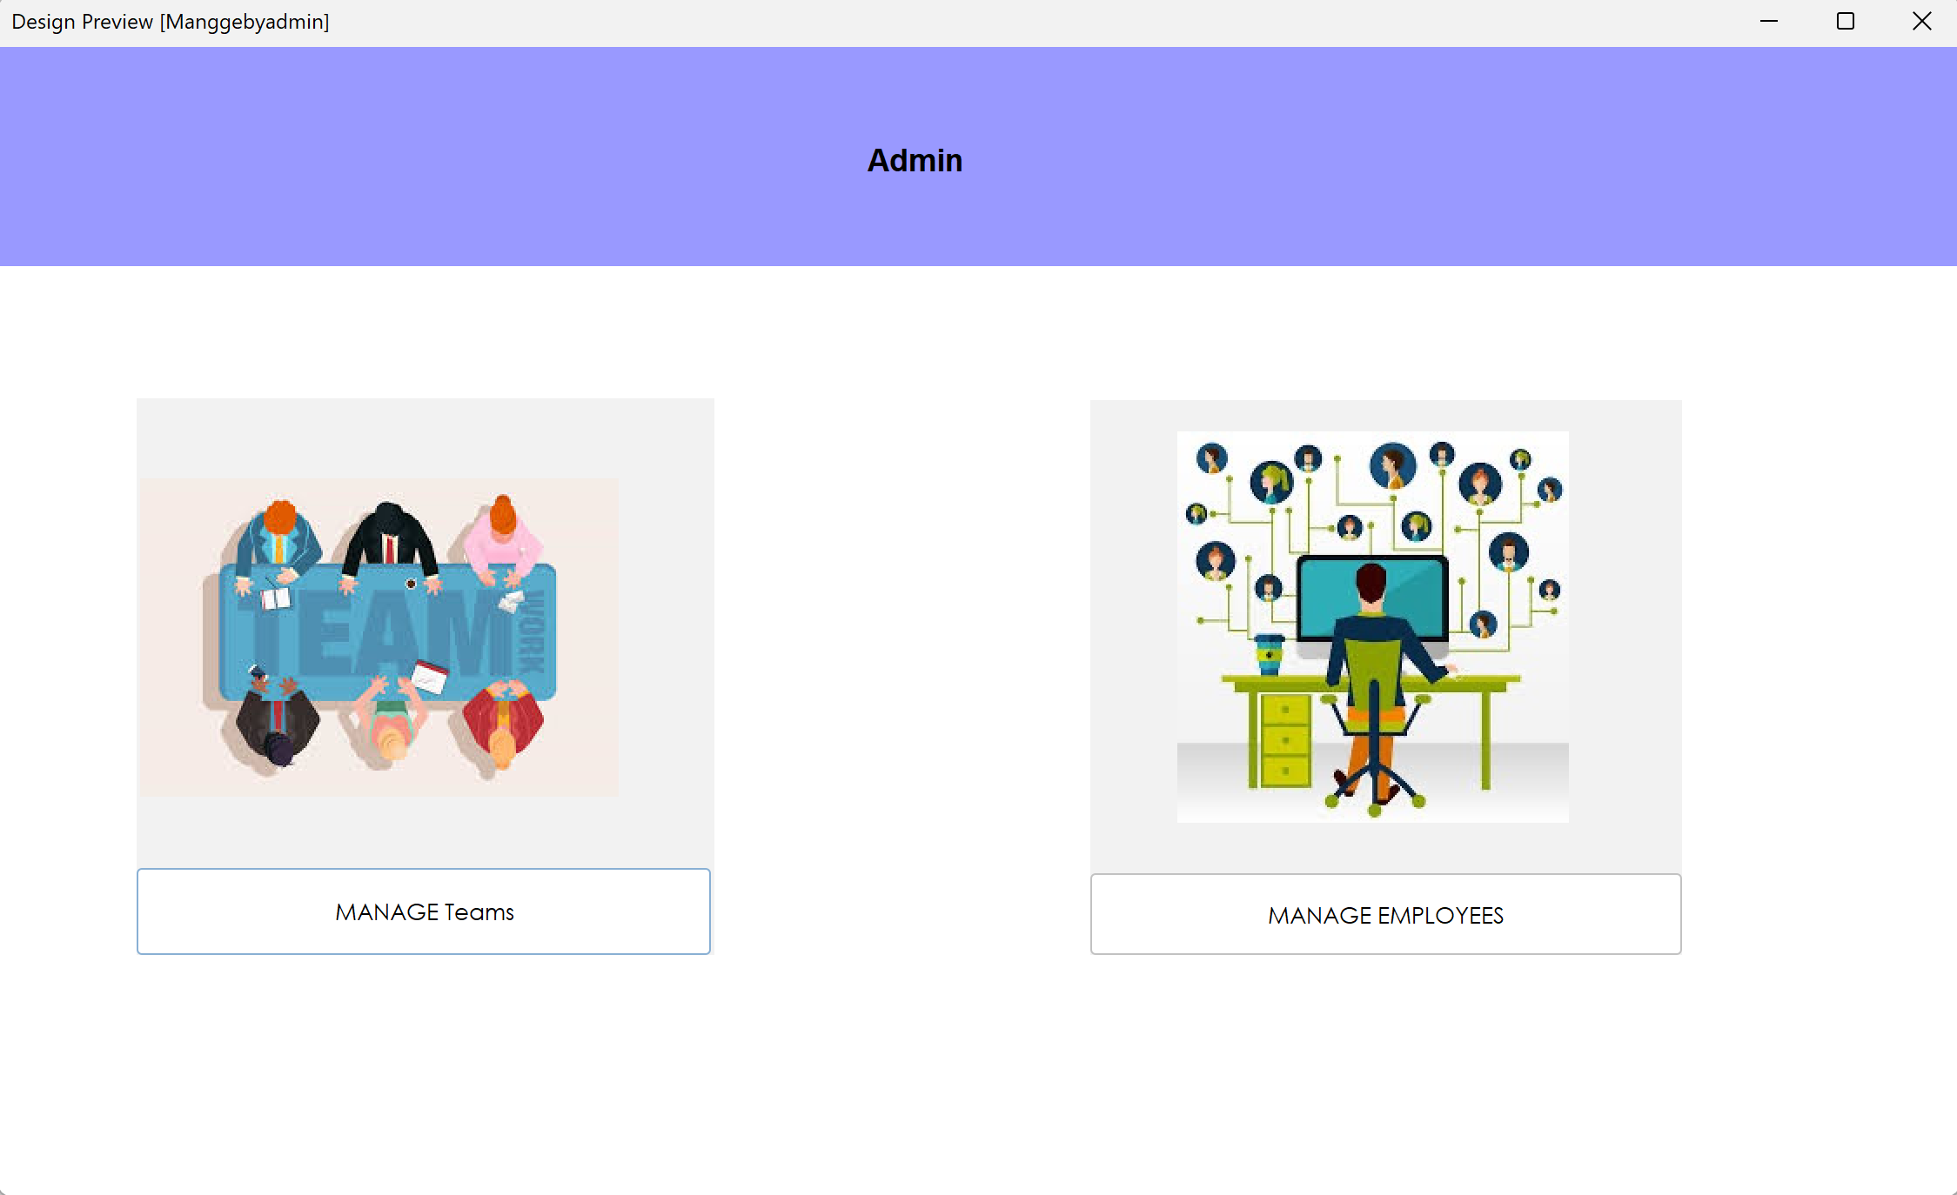
Managed by Admin

Slide 28
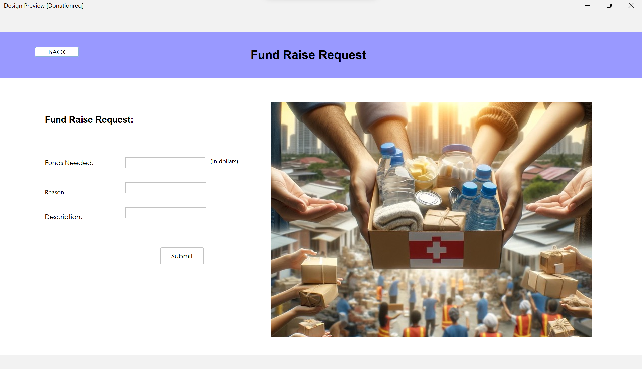
Fund Raise Request

Slide 29
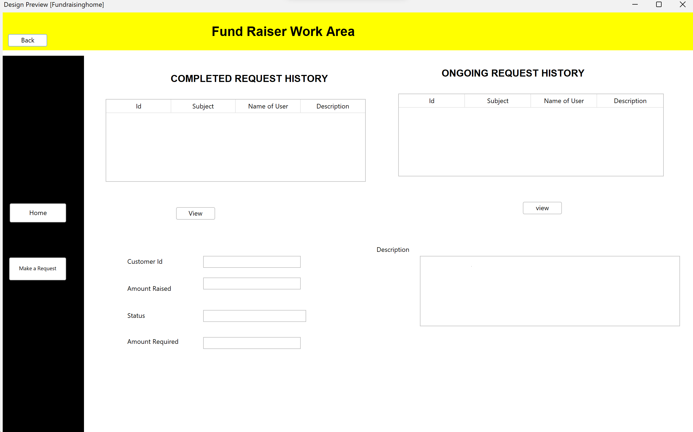
Fundraiser Work area

Slide 30
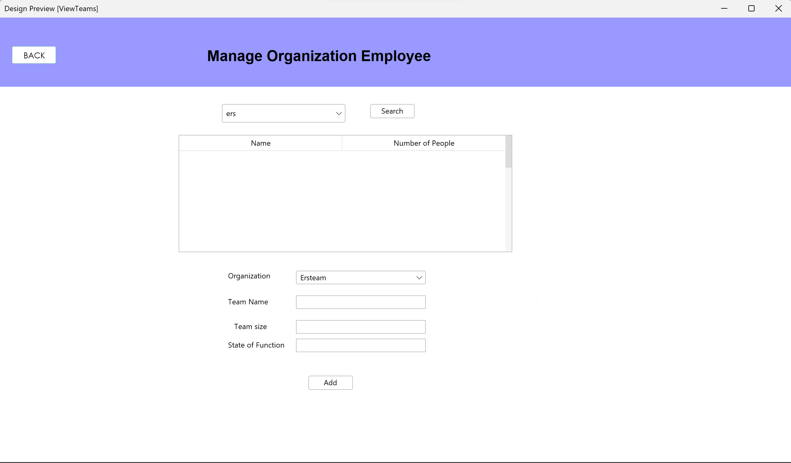
View members in Teams

Slide 31
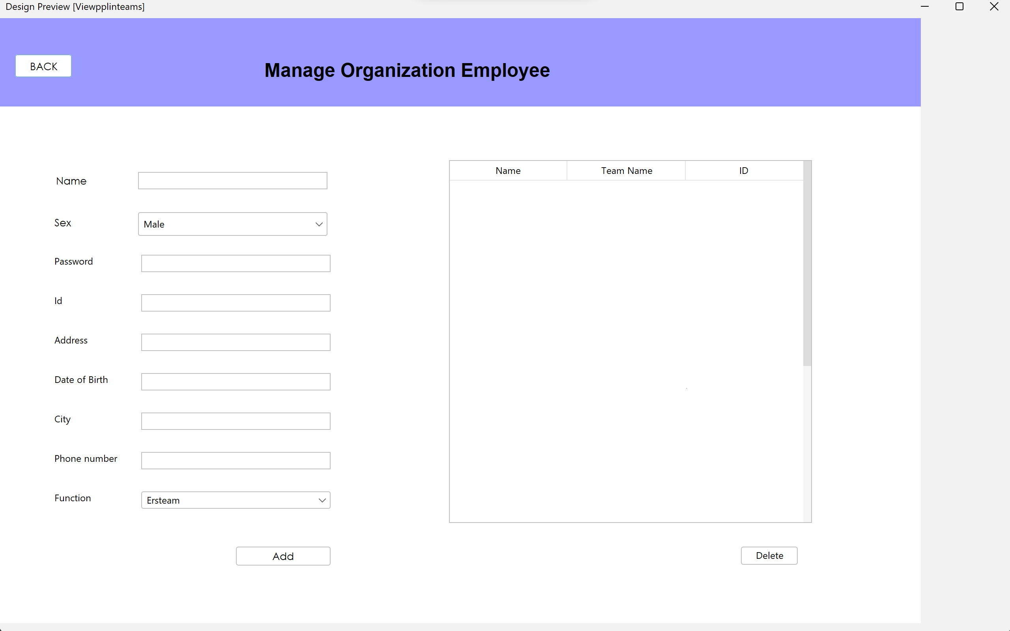
Manage Members

Slide 32
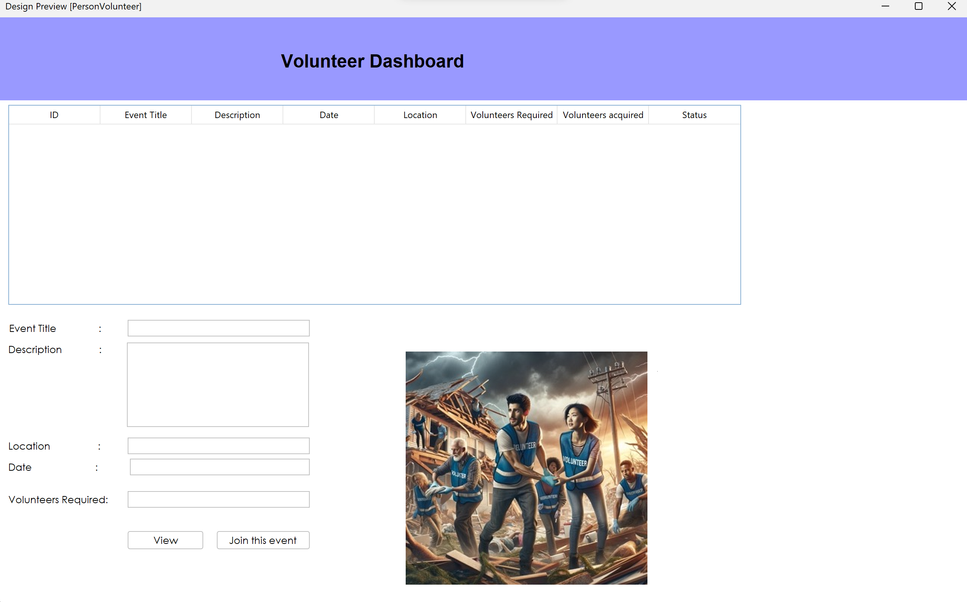
Volunteer Dashboard

Slide 33
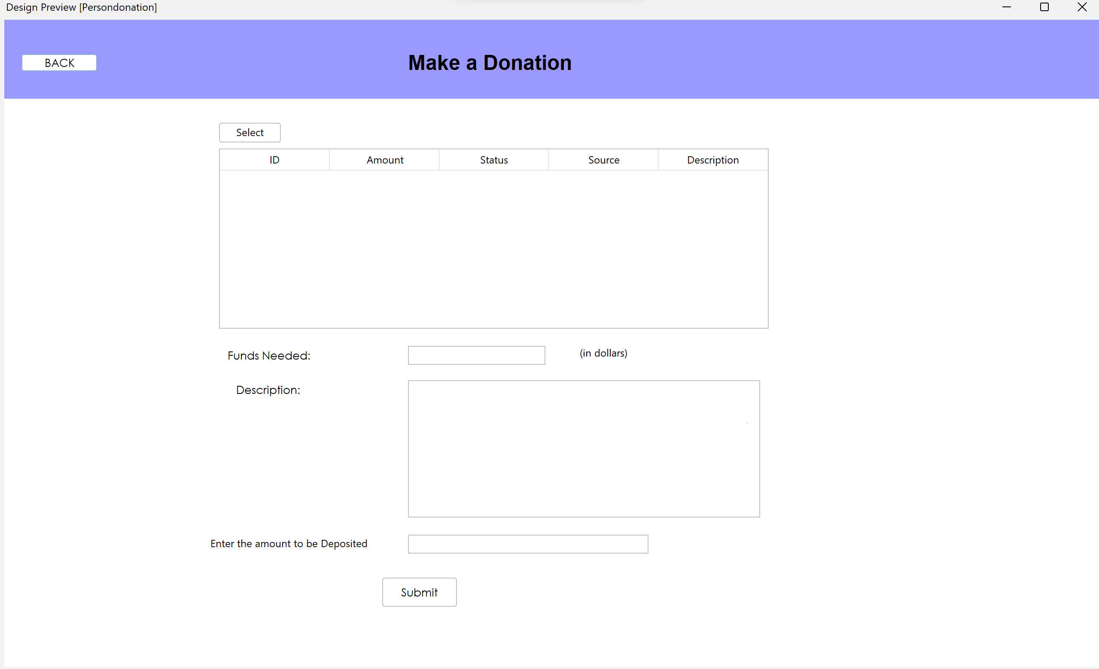
Make a Donation

Slide 34
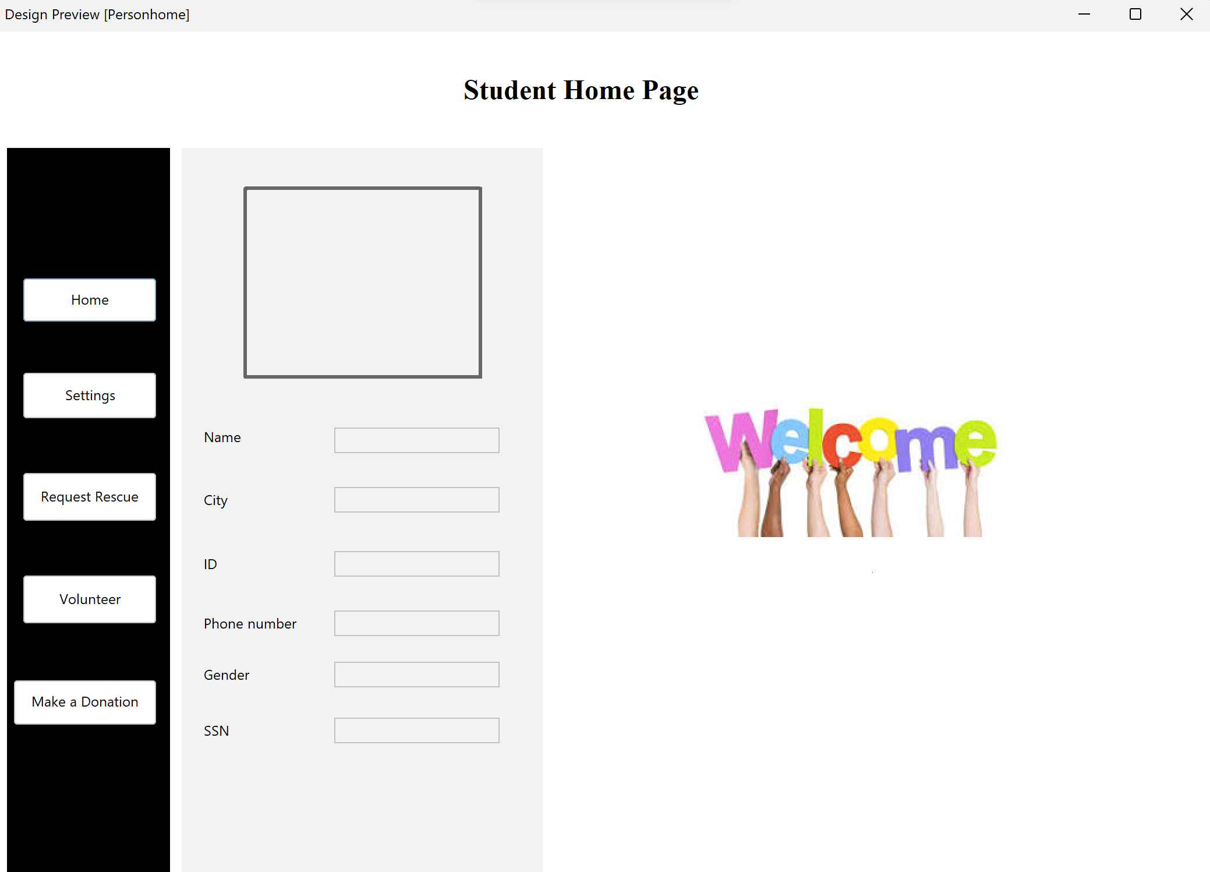
Student Home Page

Slide 35
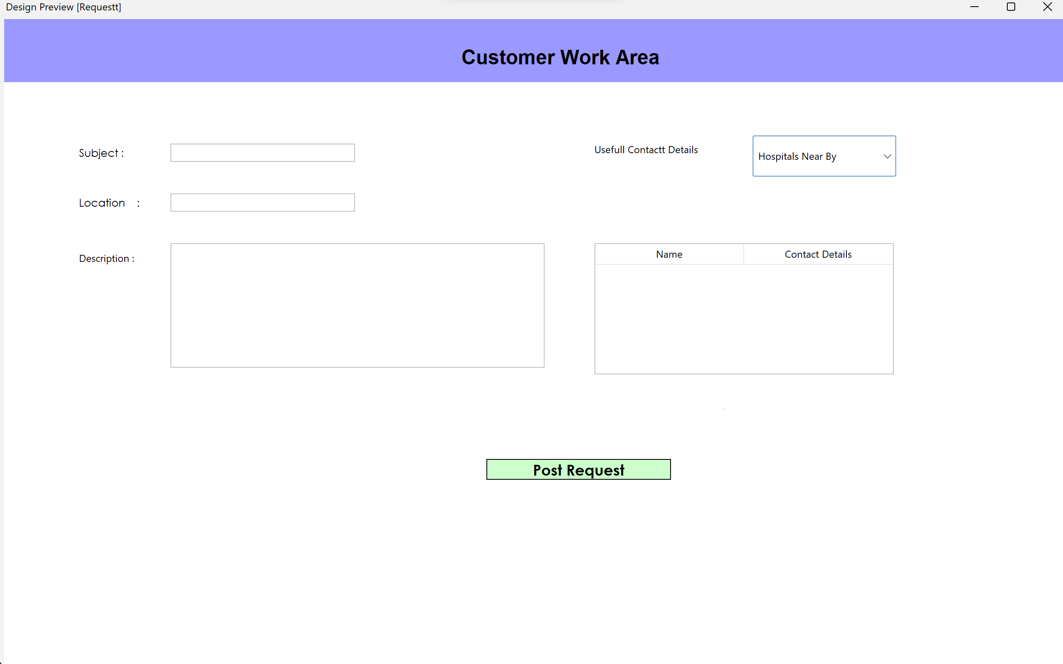
Customer Workarea

Slide 36
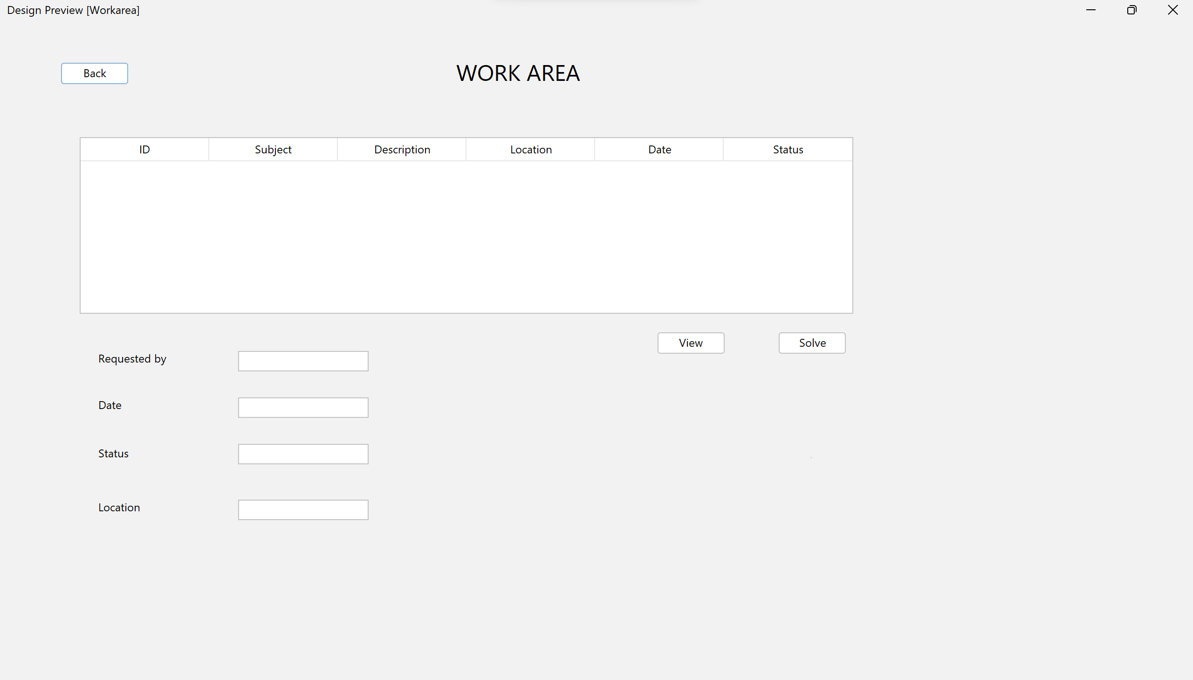
Workarea

Slide 37
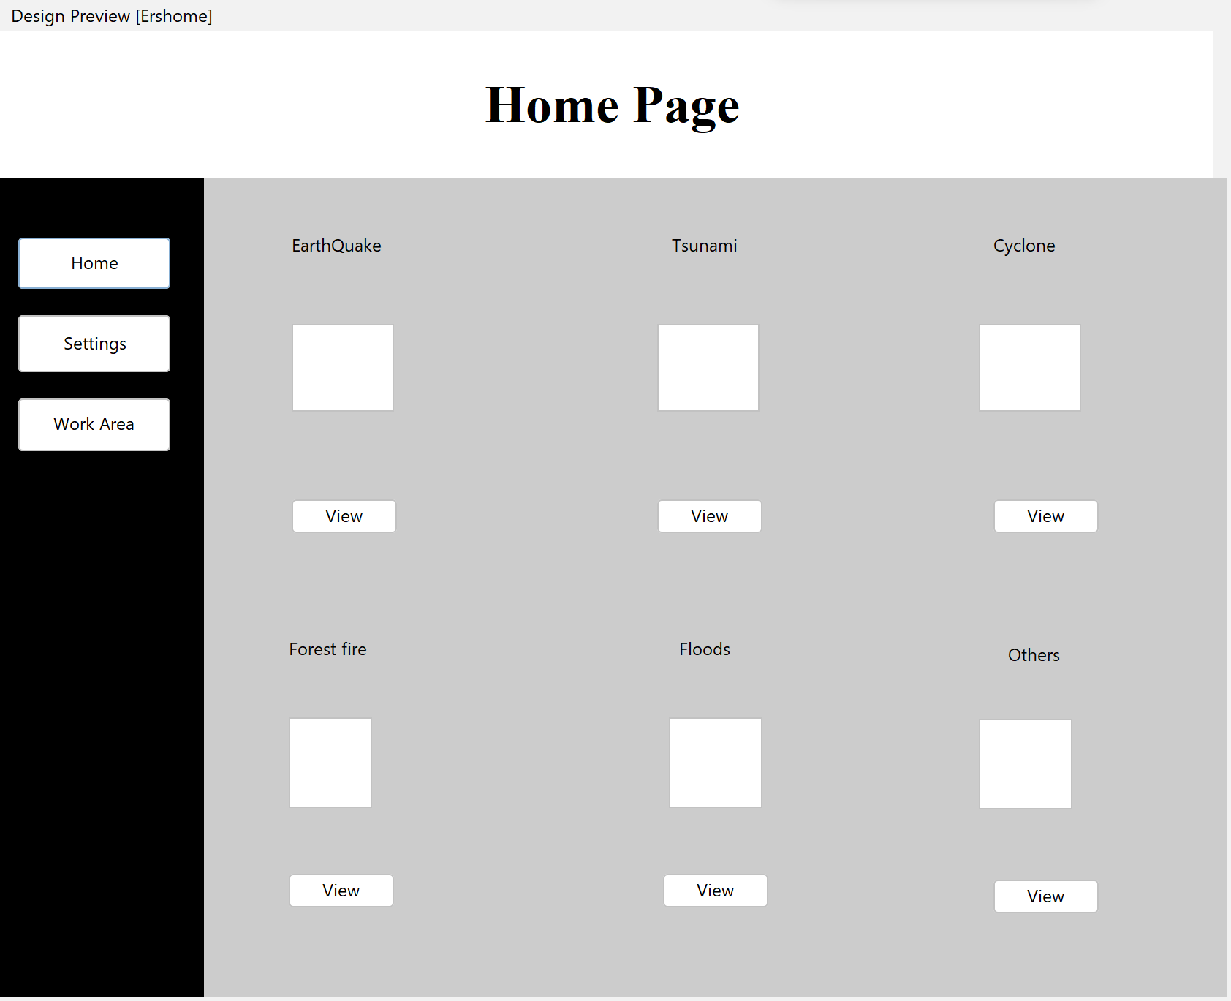
Home Page

Slide 38
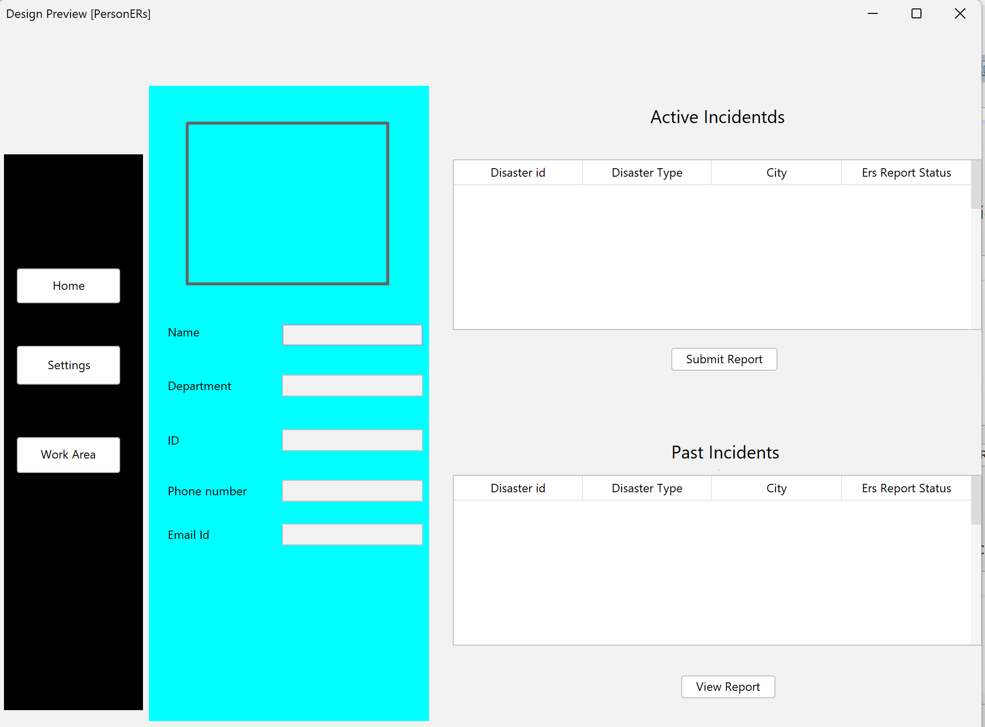
Incident Tracker

Slide 39
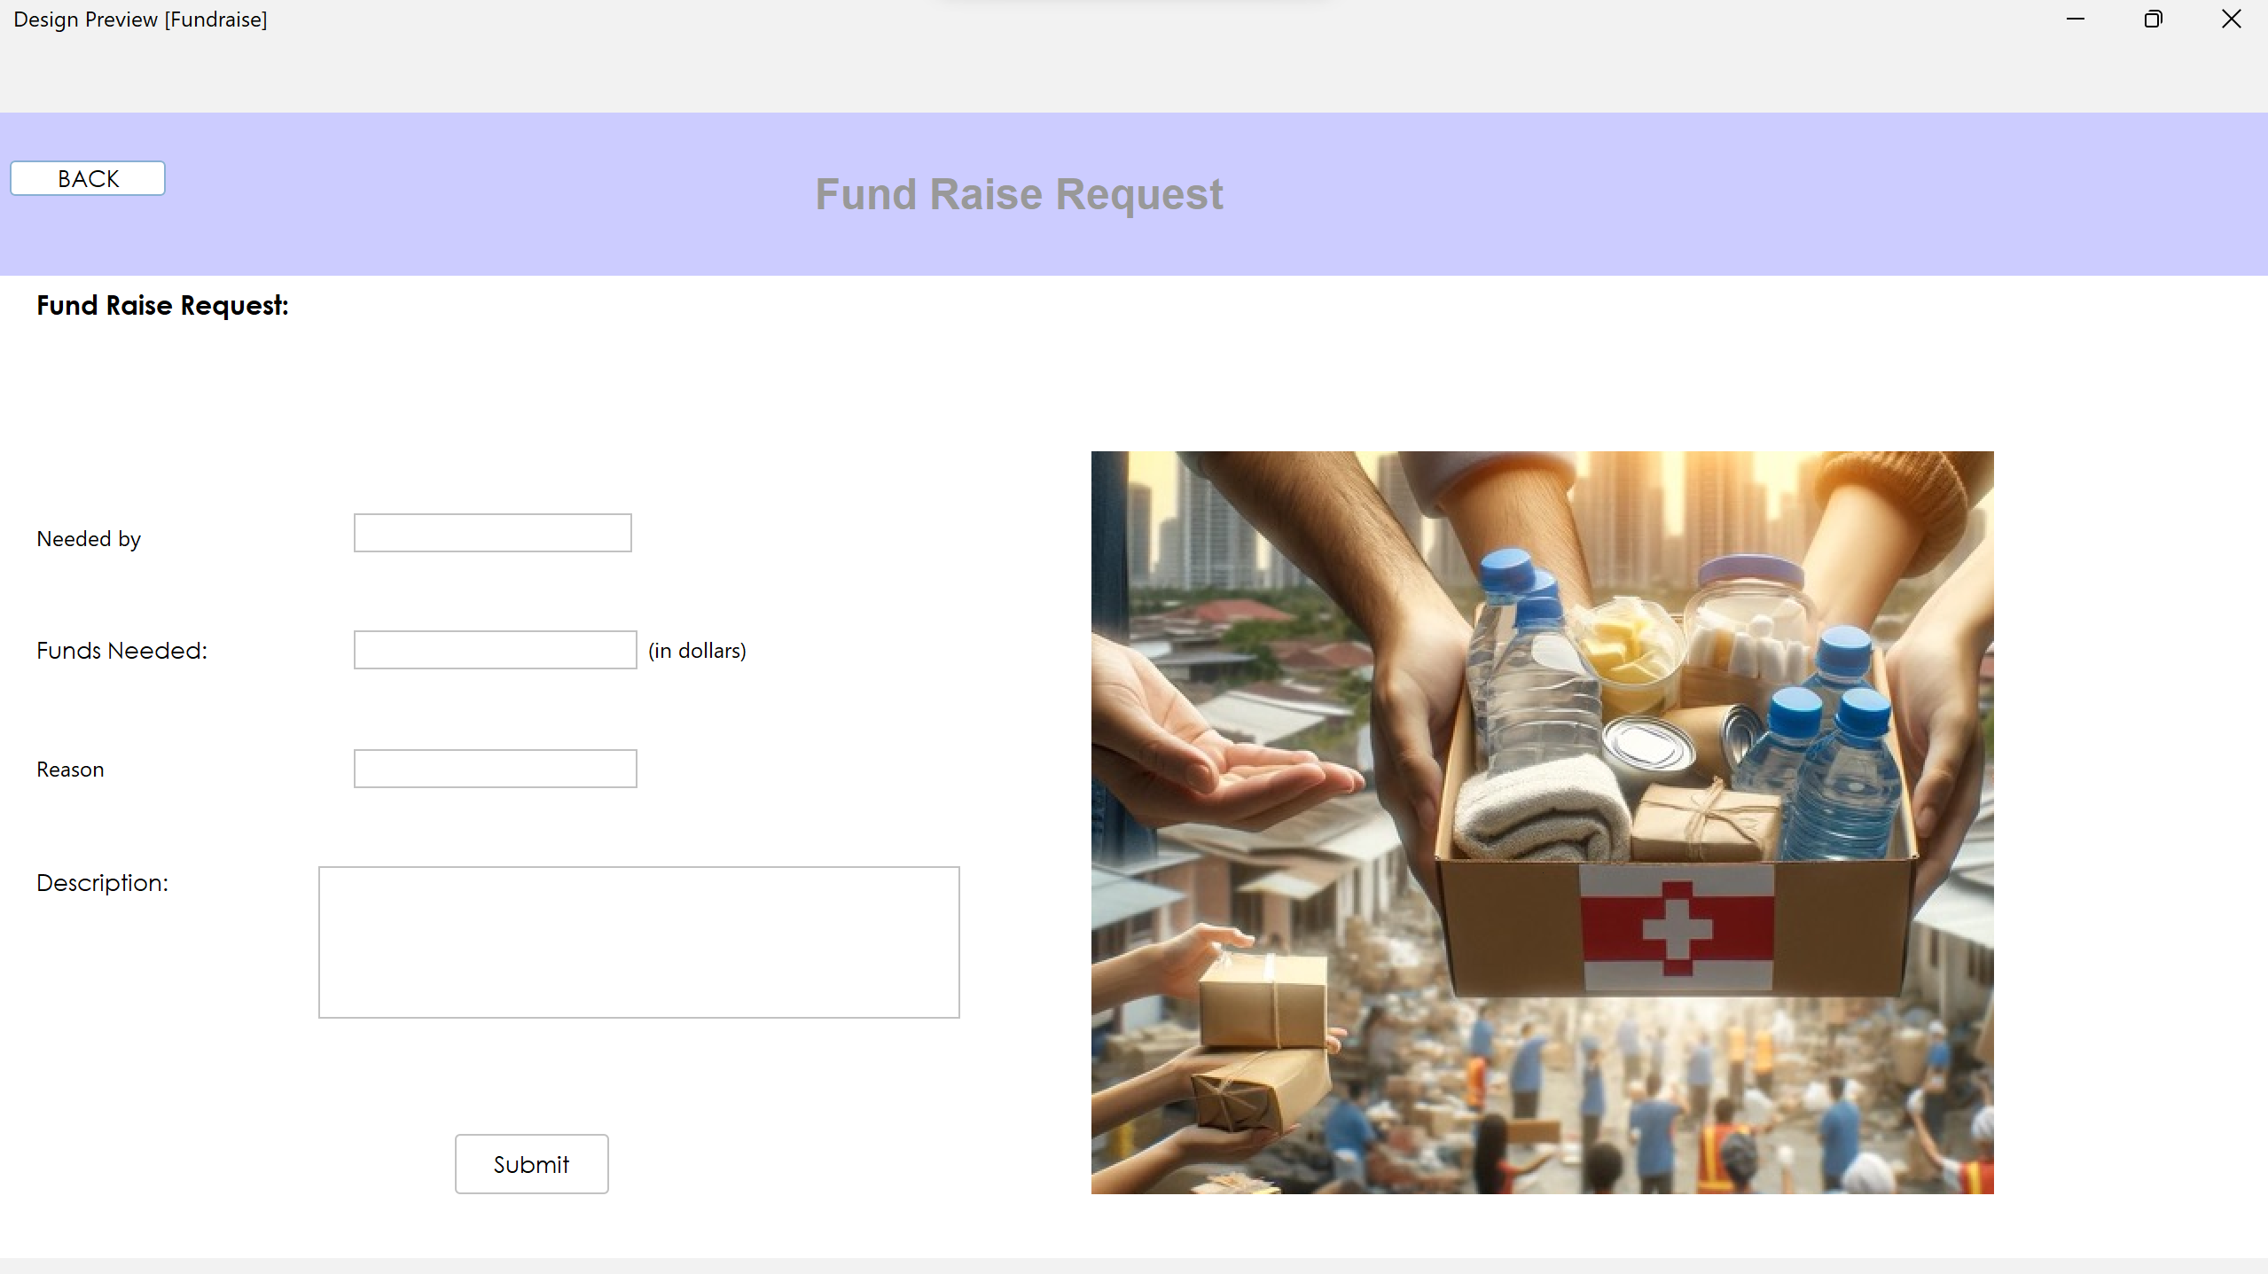
Fundraise Request

Slide 40
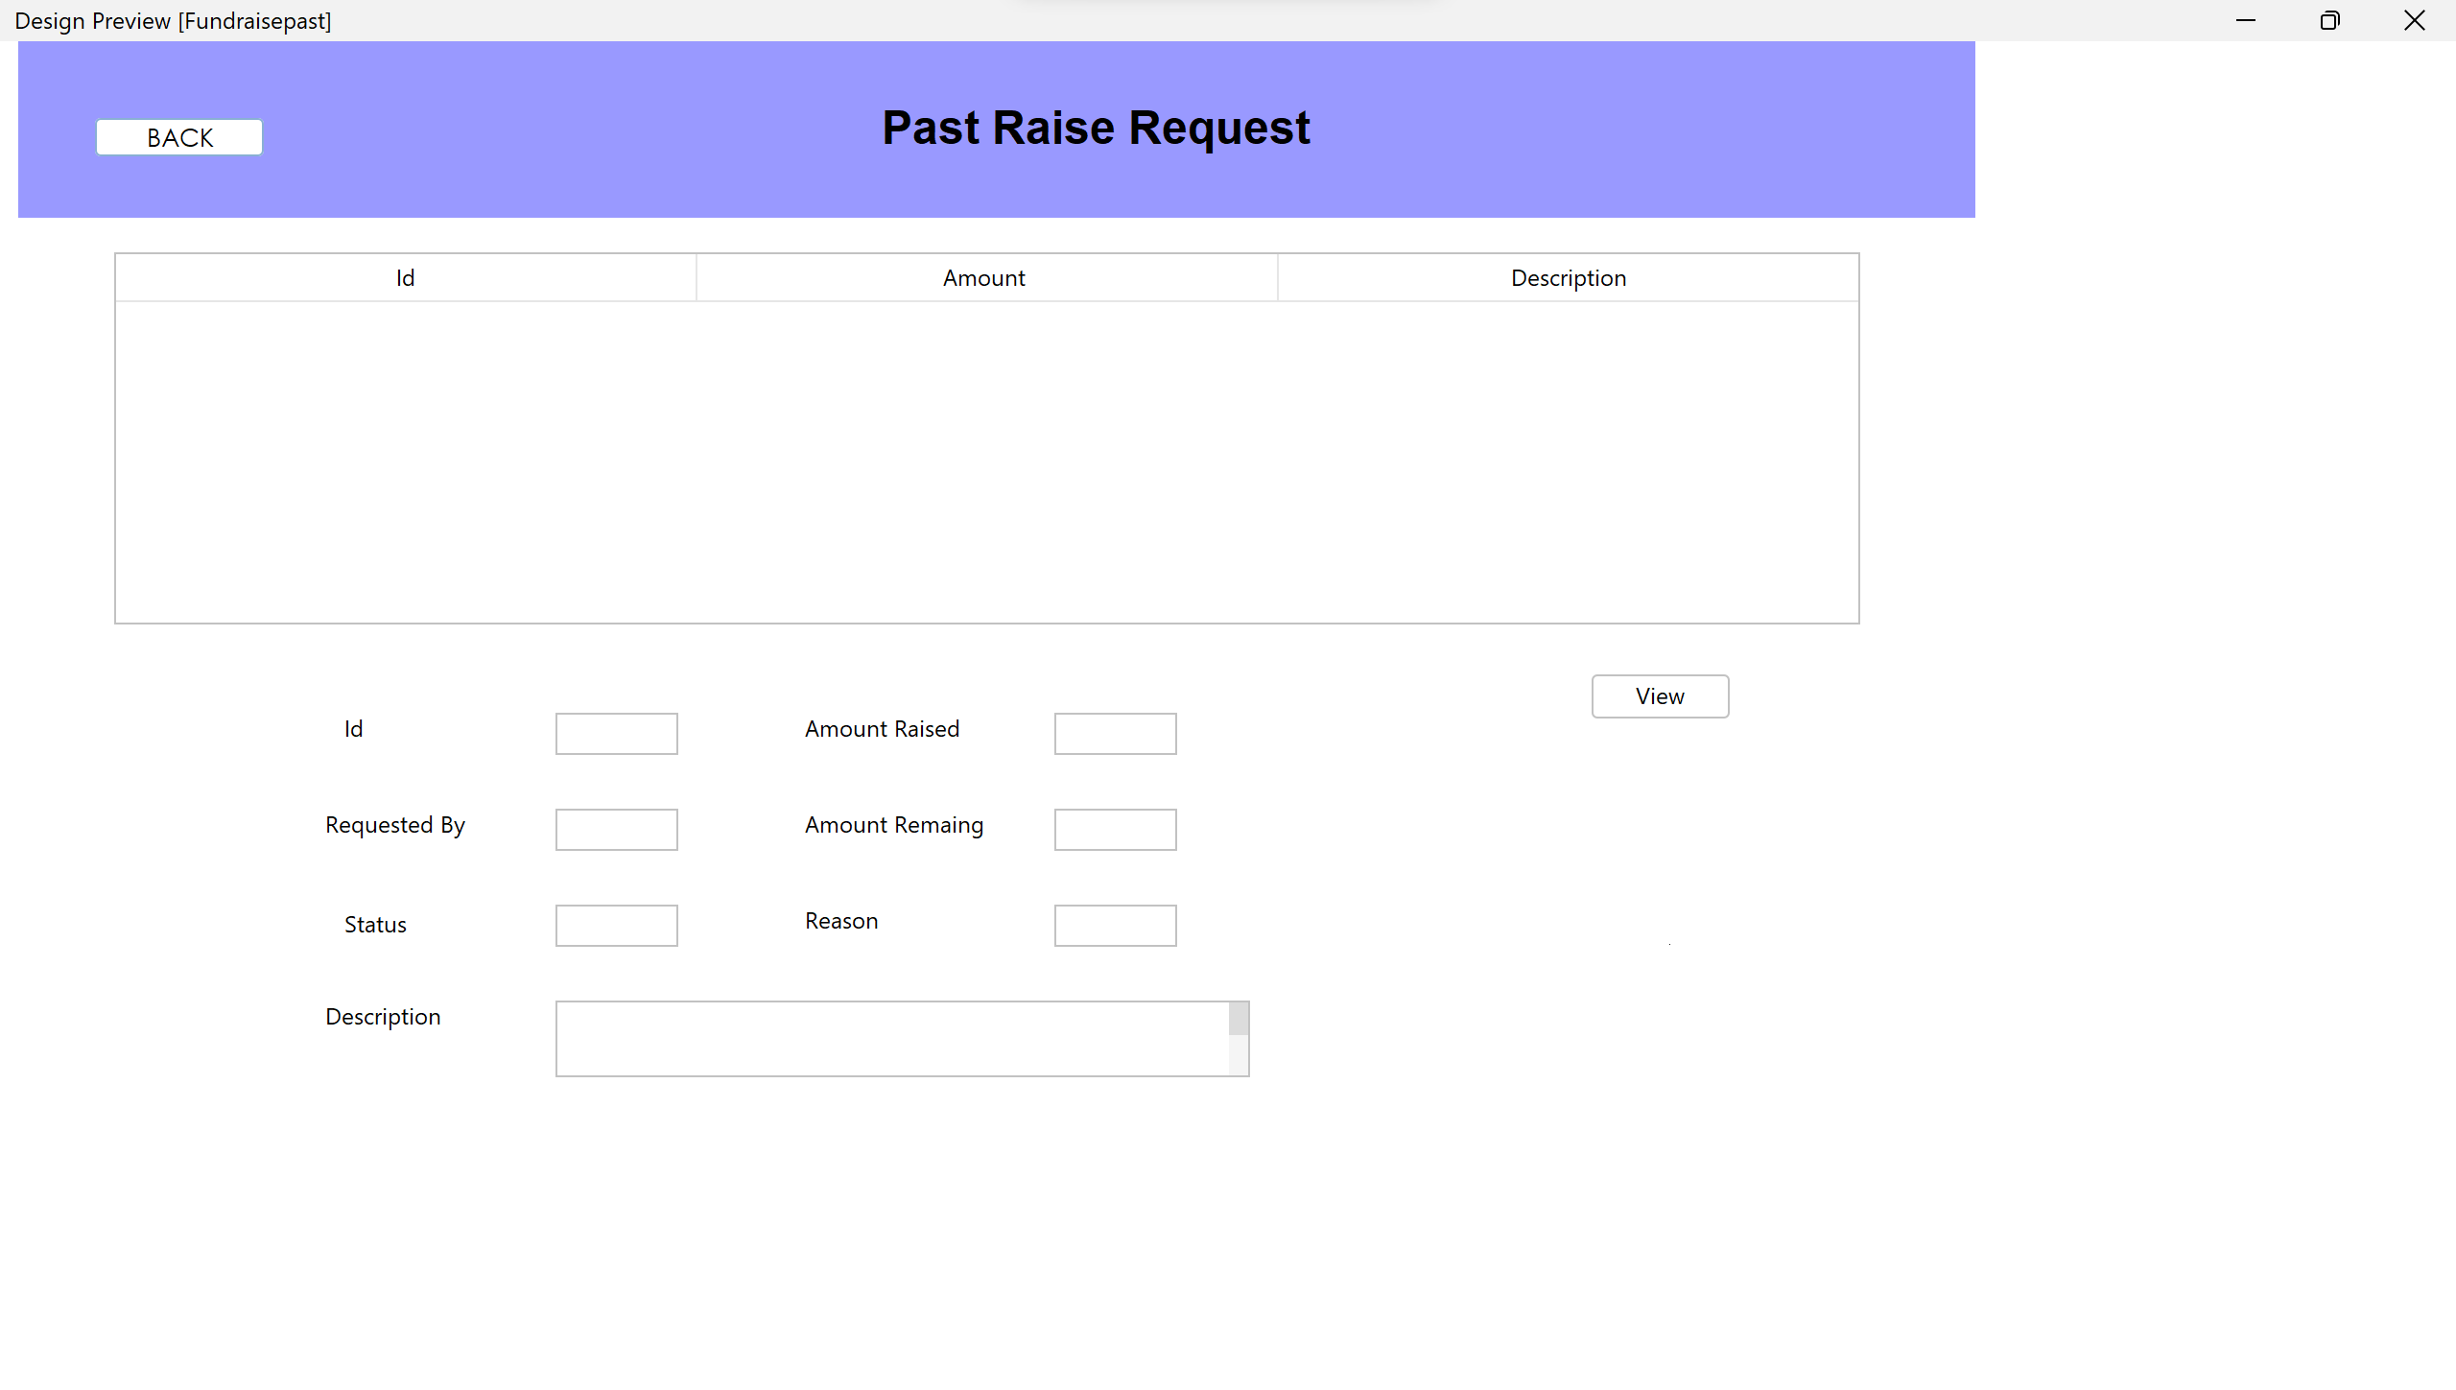
Past Raise Request

Slide 41
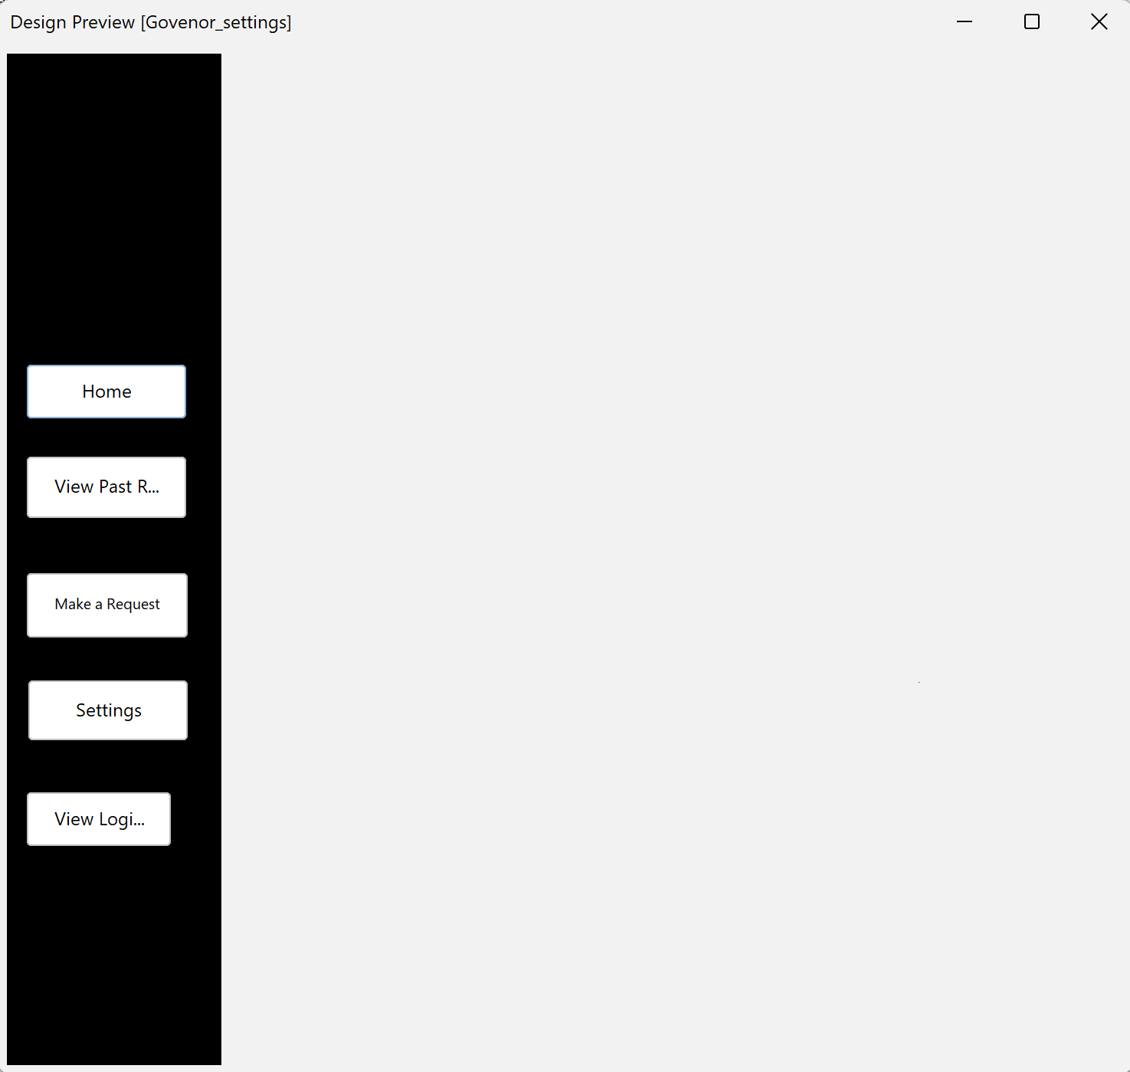
Governor Settings

Slide 42
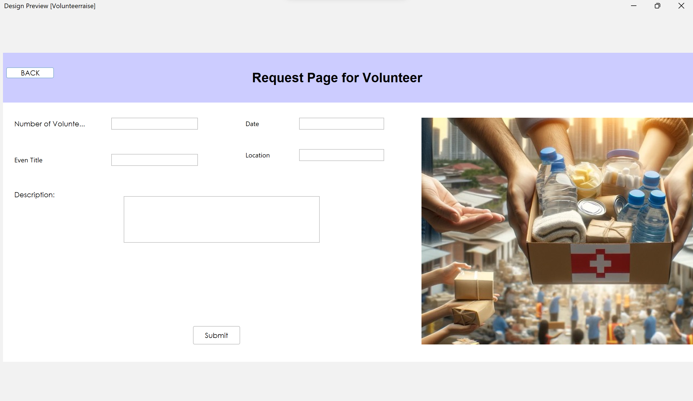
Request to be a Volunteer

Slide 43
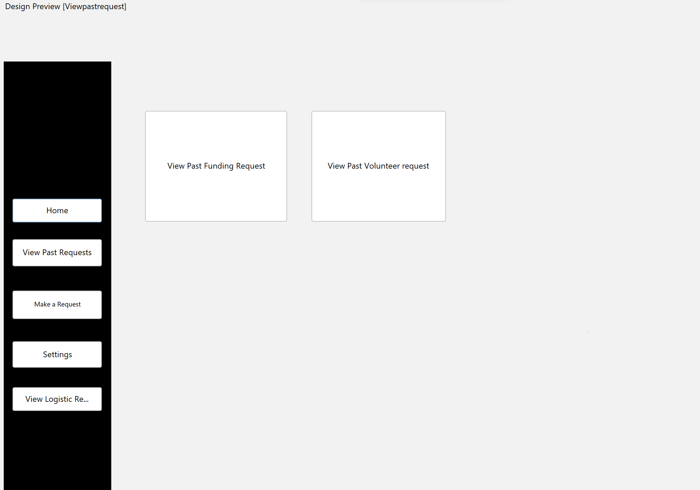
View Past Request

Slide 44
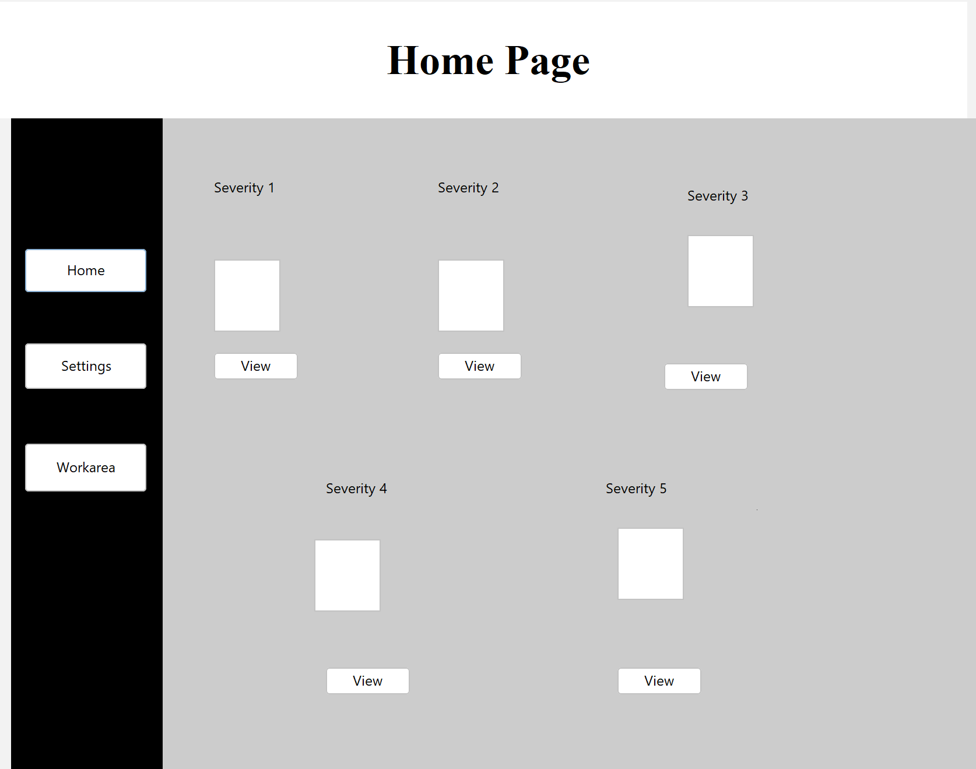
Home Page for Logistics

Slide 45
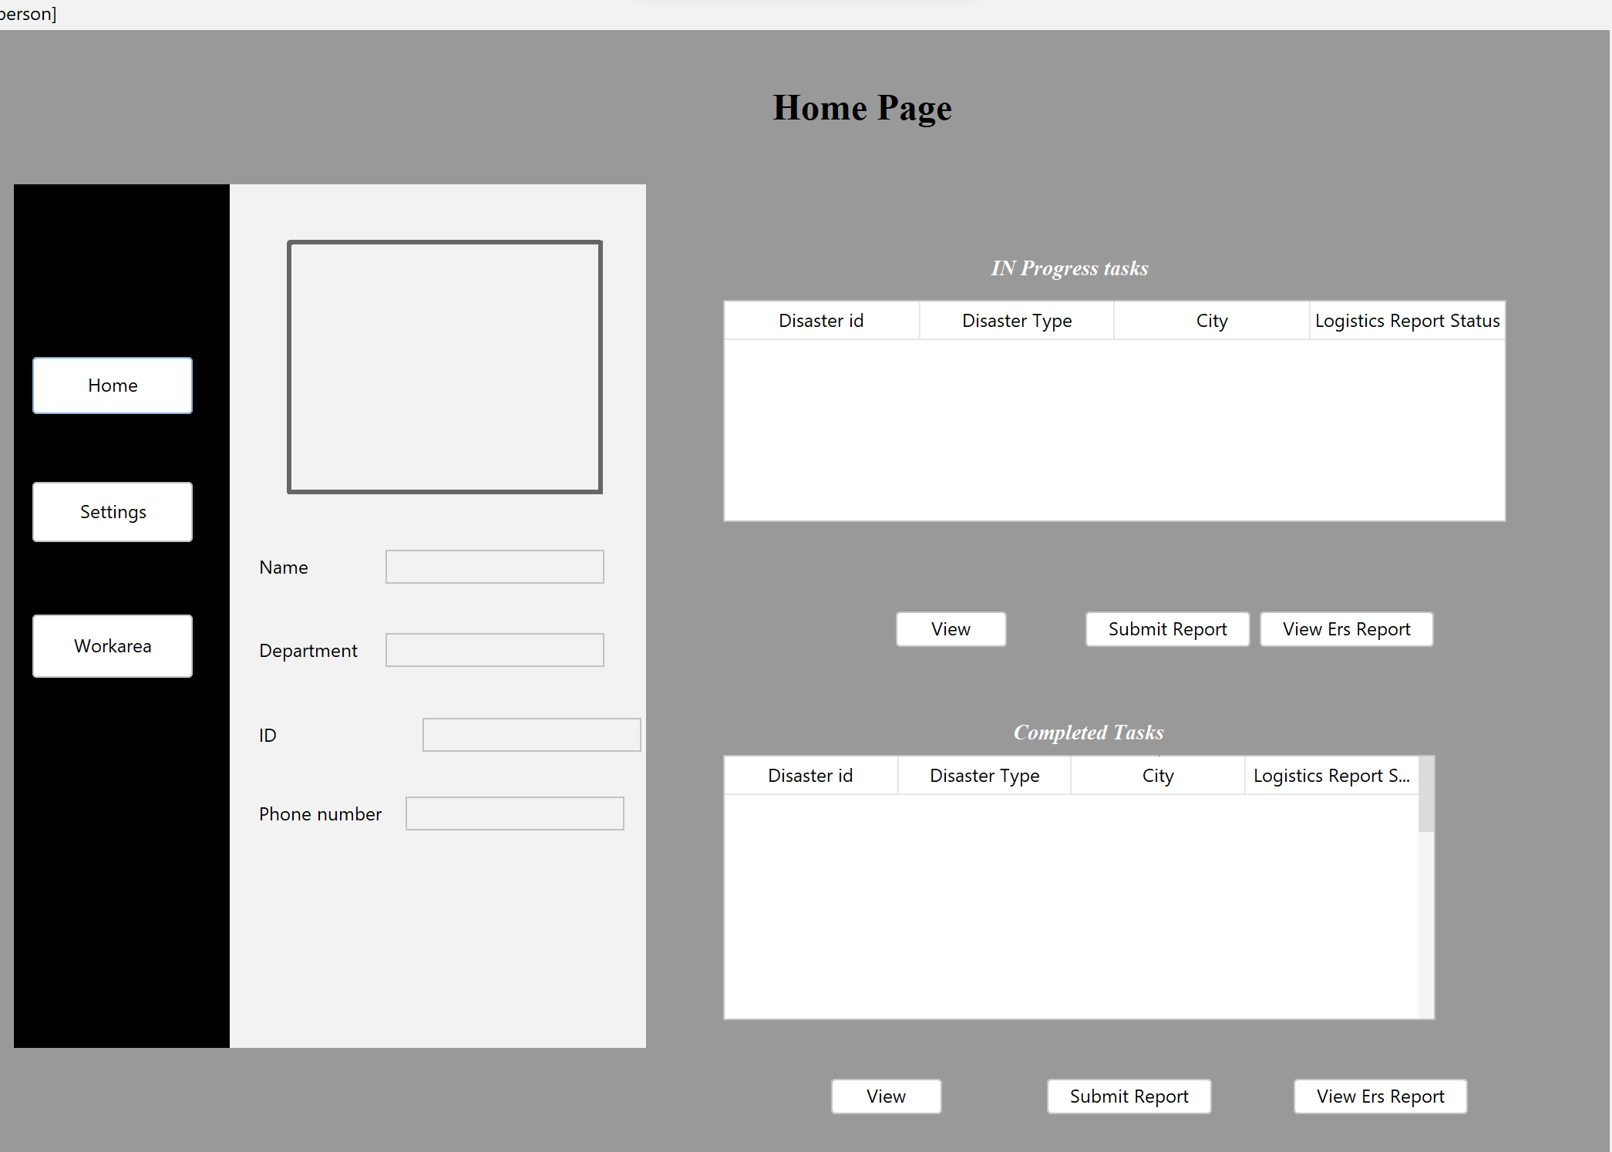
Dashboard

Slide 46
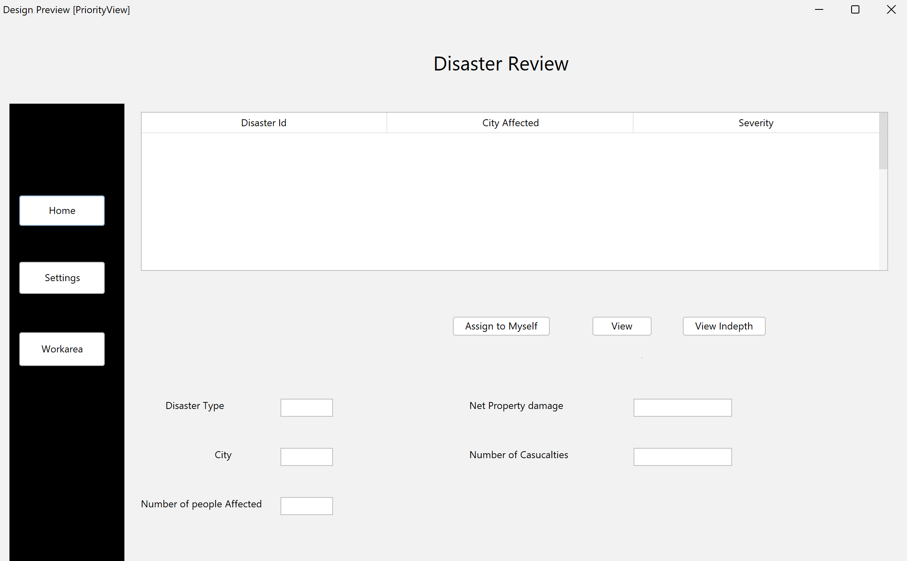
Disaster Review

Slide 47

Thanks!

